Slide 1
ICD-10-PCS Training
Lamon Willis

Slide 2
Obstetrics

Slide 3
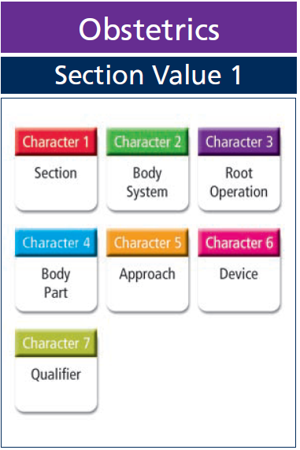
Obstetrics

Slide 4
Obstretics
Coding Note: Products of Conception
Products of conception refer to all components of pregnancy, including fetus, embryo, amnion, umbilical cord, and placenta
There is no differentiation of the products of conception based on gestational age

Slide 5
Obstretics
Character 1 | Character 2 | Character 3 | Character 4 | Character 5 | Character 6 | Character 7
Section | Body System | Root Operation | Body Part | Approach | Device | Qualifier
Examples:
Mid Forceps
Fetal Fluid

Slide 6
Root Operations in Obstetrics
Root Operations
Abortion
Change
Delivery
Drainage
Extraction
Insertion
Inspection
Removal
Repair
Reposition
Resection
Transplantation

Slide 7
Abortion - A
Abortion A | Definition | Artificially terminating a pregnancy
 | Explanation | Subdivided according to whether an additional device such as a laminaria or abortifacient is used; or whether the abortion was performed by mechanical means
 | Examples | Transvaginal abortion using vacuum aspiration technique

Slide 8
Delivery - E
Delivery E | Definition | Assisting the passage of the products of conception from the genital canal
 | Explanation | Applies only to manually-assisted, vaginal delivery
 | Examples | Manually-assisted delivery
Delivery applies only to manually-assisted, vaginal delivery and is defined as assisting the passage of products of conception from the genital canal. Cesarean deliveries are coded in this section to the root operation Extraction.

Slide 9
Drainage - 9
Drainage 9 | Definition | Taking or letting out fluids and/or gases from a body part
 | Explanation | The qualifier identifies the substance that is drained from the products of conception (fetal blood, fetal spinal fluid, amniotic fluid)
 | Examples | Amniocentesis, percutaneous fetal spinal tap

Slide 10
Other Services

Slide 11
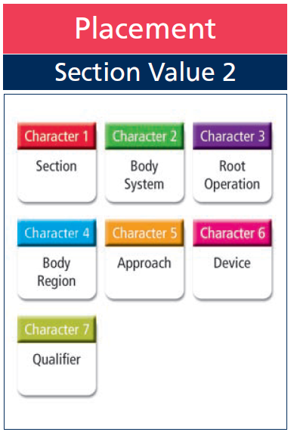
Placement

Slide 12
Placement
Character 1 | Character 2 | Character 3 | Character 4 | Character 5 | Character 6 | Character 7
Section | Body System | Root Operation | Body Region | Approach | Device | Qualifier
Look at the Device Character—what is classified here?

Slide 13
Root Operations for Placement
Root Operations
Change
Compression
Dressing
Immobilization
Packing
Removal
Traction

Slide 14
Devices in Placement Section
Specifies the material or device in placement procedure (e.g., splint, traction apparatus, pressure dressing, bandage)
Includes casts for fractures and dislocations
Devices in the Placement section are off the shelf and do not require any extensive design, fabrication or fitting
The placement of devices that require extensive design, fabrication or fitting are coded in the Rehabilitation section of ICD-10-PCS

Slide 15
Packing - 4
Packing 4 | Definition | Putting material in a body region or orifice
 | Explanation | Procedures performed without making an incision or puncture
 | Examples | Placement of nasal packing

Slide 16
Dressing - 2
Dressing 2 | Definition | Putting material on a body region for protection
 | Explanation | Procedures performed without making an incision or puncture
 | Examples | Application of sterile dressing to head wound

Slide 17
Traction - 6
Traction 6 | Definition | Exerting a pulling force on a body region in a distal direction
 | Explanation | Traction in this section includes only the task performed using a mechanical traction apparatus
 | Examples | Lumbar traction using motorized split-traction table

Slide 18
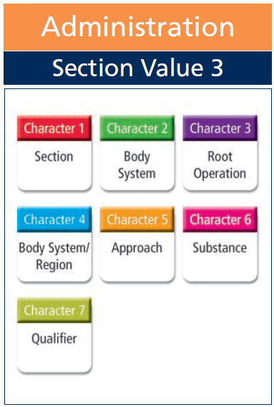
Administration - 3

Slide 19
Administration - 3
Character 1 | Character 2 | Character 3 | Character 4 | Character 5 | Character 6 | Character 7
Section | Body System | Root Operation | Body System/ Region | Approach | Substance | Qualifier

Slide 20
Administration - 3
Root Operations
All new Root Operations – See definitions in PCS codebook
Introduction
Irrigation
Transfusion

Slide 21
Administration - 3
Coding Note: Administration Section
The Administration section includes infusions, injections, and transfusions, as well as other related procedures, such as irrigation and tattooing.
All codes in this section define procedures where a diagnostic or therapeutic substance is given to the patient.

Slide 22
Substances in Administration Section
Physiological Systems and Anatomical Regions
Anti-inflammatory | Anti-infective | Antineoplastic | Antiarrhythmic
Dialysate | Electrolytic and Water Balance Substance | Gas | Intracirculatory Anesthetic
Local Anesthetic | Nutritional Substance | Pancreatic Islet Cells | Pigment
Platelet Inhibitor | Radioactive Substance | Regional Anesthetic | Serum, Toxoid and Vaccine
Sperm | Stem Cells, Embryonic | Stem Cells, Somatic | Thrombolytic

Slide 23
Substances in Administration Section
Circulatory
Antihemolytic factor | Bone Marrow | Factor IX | Fibrinogen
Fresh Plasma | Frozen Plasma | Globulin | Platelets
Red Blood Cells | Frozen Red Cells | Serum Albumin | Whole Blood

Slide 24
Transfusion - 2
Transfusion 2 | Definition | Putting in blood or blood products
 | Explanation | Substance given is a blood product or a stem cell substance
 | Examples | Transfusion of cell saver red cells into central venous line

Slide 25
Irrigation - 1
Irrigation 1 | Definition | Putting in or on a cleansing substance
 | Explanation | Substance given is a cleansing substance or dialysate
 | Examples | Flushing of eye

Slide 26
Introduction - 0
Introduction 0 | Definition | Putting in or on a therapeutic, diagnostic, nutritional, physiological or prophylactic substance except blood or blood products
 | Explanation | All other substances administered, such as anti-neoplastic substance
 | Examples | Nerve block injection to median nerve

Slide 27
Introduction - 0
Coding Note: Substance for Mixed Steroid and Local Anesthetic
When a substance of mixed steroid and local anesthetic is given for pain control it is coded to the substance value ANTI-INFLAMMATORY. The anesthetic is only added to lessen the pain of the injection.

Slide 28
Introduction - 0
Coding Note: Body Part Value
For the root operation Introduction, the body part value specifies where the procedure occurs and not necessarily the site where the substance introduced has an effect.

Slide 29
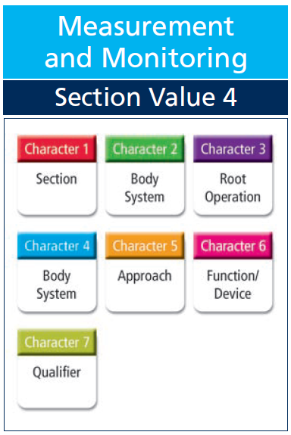
Measurement & Monitoring

Slide 30
Measurement & Monitoring
Character 1 | Character 2 | Character 3 | Character 4 | Character 5 | Character 6 | Character 7
Section | Body System | Root Operation | Body System | Approach | Function/ Device | Qualifier

Slide 31
Measurement - 0
Measurement 0 | Definition | Determining the level of a physiological or physical function at a point in time
 | Explanation | A single temperature reading is considered a measurement
 | Examples | EGD with biliary flow measurement

Slide 32
Monitoring - 1
Monitoring 1 | Definition | Determining the level of a physiological or physical function repetitively over a period of time
 | Explanation | Temperature taken every half hour for 8 hours is considered monitoring
 | Examples | Urinary pressure monitoring

Slide 33
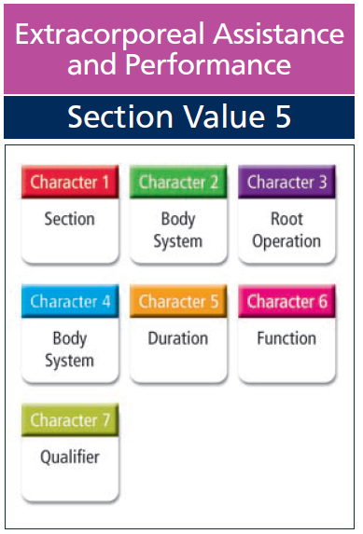
Extracorporeal Assistance & Performance - 5

Slide 34
Extracorporeal Assistance & Performance - 5
Character 1 | Character 2 | Character 3 | Character 4 | Character 5 | Character 6 | Character 7
Section | Body System | Root Operation | Body System | Duration | Function | Qualifier

Slide 35
Extracorporeal Assistance & Performance - 5
Coding Note: Character 5 – Duration
For respiratory ventilation assistance or performance, the range of consecutive hours is specified (<24 hours, 24-96 hours, or >96 hours).

Slide 36
Assistance - 0
Assistance 0 | Definition | Taking over a portion of a physiological function by extracorporeal means
 | Explanation | Procedures that support a physiological function but do not take complete control of it, such as intra-aortic balloon pump to support cardiac output and hyperbaric oxygen treatment
 | Examples | Hyperbaric oxygenation of wound

Slide 37
Performance - 1
Performance 1 | Definition | Completely taking over a physiological function by extracorporeal means
 | Explanation | Procedures in which complete control is exercised over a physiological function, such as total mechanical ventilation, cardiac pacing and cardiopulmonary bypass
 | Examples | Cardiopulmonary bypass in conjunction with CABG

Slide 38
Restoration - 2
Restoration 2 | Definition | Returning, or attempting to return, a physiological function to its original state by extracorporeal means
 | Explanation | Restoration defines only external cardioversion and defibrillation procedures. Failed cardioversion procedures are also included in the definition of Restoration and are coded the same as successful procedures
 | Examples | Attempted cardiac defibrillation, unsuccessful

Slide 39
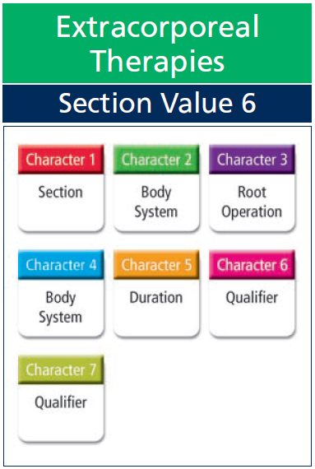
Extracorporeal Therapies - 6

Slide 40
Extracorporeal Therapies - 6
Character 1 | Character 2 | Character 3 | Character 4 | Character 5 | Character 6 | Character 7
Section | Body System | Root Operation | Body System | Duration | Qualifier | Qualifier

Slide 41
Root Operations in Extracorporeal Therapies Section
Root Operations
Atmospheric Control
Decompression
Electromagnetic Therapy
Hyperthermia
Hypothermia
Pheresis
Phototherapy
Shock Wave Therapy
Ultrasound Therapy
Ultraviolet Light Therapy

Slide 42
Root Operations in Extracorporeal Therapies Section
Coding Note: Decompression
Decompression describes a single type of procedure—treatment for decompression sickness (the bends) in a hyperbaric chamber.

Slide 43
Root Operations in Extracorporeal Therapies Section
Coding Note: Hyperthermia
Hyperthermia is used both to treat temperature imbalance and as an adjunct radiation treatment for cancer. When performed to treat temperature imbalance, the procedure is coded to this section.
When performed for cancer treatment, whole-body hyperthermia is classified as a modality qualifier in section D, Radiation Therapy

Slide 44
Root Operations in Extracorporeal Therapies Section
Coding Note: Pheresis
Pheresis is used in medical practice for two main purposes; to treat diseases where too much of a blood component is produced, such as leukemia, or to remove a blood product such as platelets from a donor, for transfusion into a patient who needs them.

Slide 45
Root Operations in Extracorporeal Therapies Section
Coding Note: Phototherapy
Phototherapy to the circulatory system means exposing the blood to light rays outside the body using a machine that recirculates the blood and returns it to the body after phototherapy.

Slide 46
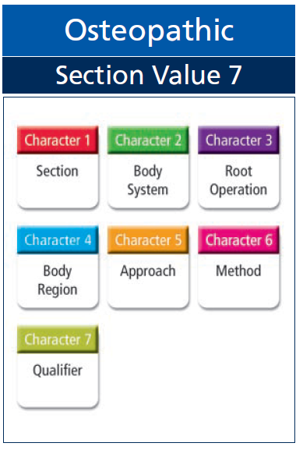
Osteopathic - 7

Slide 47
Osteopathic - 7
Character 1 | Character 2 | Character 3 | Character 4 | Character 5 | Character 6 | Character 7
Section | Body System | Root Operation | Body Region | Approach | Method | Qualifier

Slide 48
Osteopathic Methods **6
Osteopathic Methods
Articulatory-Raising | Fascial Release | General Mobilization | High Velocity-Low Amplitude
Indirect | Low Velocity-High Amplitude | Lymphatic Pump | Muscle Energy - Isometric
Muscle Energy – Isotonic | Other Method

Slide 49
Osteopathic - 7
Coding Note: Osteopathic Section
Section 7, Osteopathic, is one of the smallest sections in ICD-10-PCS.
There is a single body system, Anatomic Regions, and a single root operation, Treatment.

Slide 50
Treatment - 0
Treatment 0 | Definition | Manual treatment to eliminate or alleviate somatic dysfunction and related disorder
 | Explanation | None
 | Examples | Fascial release of abdomen, osteopathic treatment

Slide 51
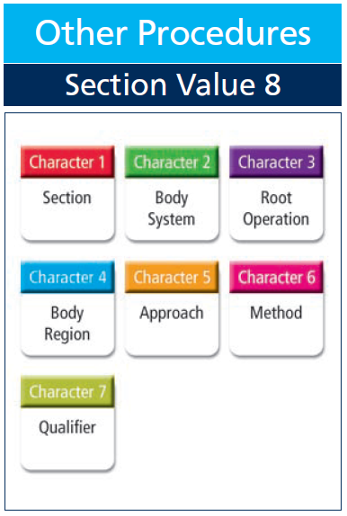
Other Procedures - 8

Slide 52
Other Procedures - 8
Character 1 | Character 2 | Character 3 | Character 4 | Character 5 | Character 6 | Character 7
Section | Body System | Root Operation | Body Region | Approach | Method | Qualifier

Slide 53
Other Procedures - 8
Coding Note: Other Procedure Section
The Other Procedure section contains codes for procedures not included in the other Medical and Surgical-related sections.
There are relatively few procedures coded in this section.
Whole body therapies, including acupuncture and meditation, are included in this section along with a code for the fertilization portion of an in-vitro procedure.
This section also contains codes for robotic-assisted procedures and computer-assisted procedures.

Slide 54
Other Procedures - 0
Other Procedures 0 | Definition | Methodologies that attempt to remediate or cure a disorder or disease
 | Explanation | For nontraditional, whole-body therapies including acupuncture and meditation
 | Examples | Acupuncture

Slide 55
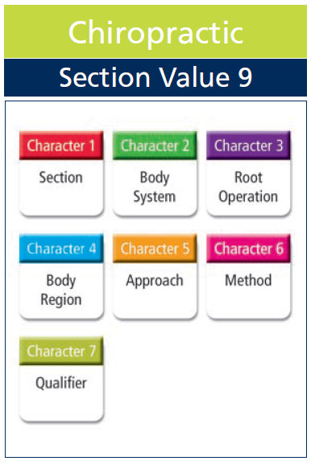
Chiropractic - 9

Slide 56
Chiropractic - 9
Character 1 | Character 2 | Character 3 | Character 4 | Character 5 | Character 6 | Character 7
Section | Body System | Root Operation | Body Region | Approach | Method | Qualifier

Slide 57
Chiropractic - 9
Coding Note: Chiropractic Section
Section 9, Chiropractic Section, consists of a single body system, Anatomical Regions, and a single root operation, Manipulation.

Slide 58
Manipulation - B
Manipulation B | Definition | Manual procedures that involves a direct thrust to move a joint past the physiological range of motion, without exceeding the anatomical limit
 | Explanation | None
 | Examples | Chiropractic treatment of cervical spine, short lever specific contact

Slide 59
Quiz
Chiropractic treatment of lumbar spine using long and short lever specific contact.
Code(s): ______________

Slide 60
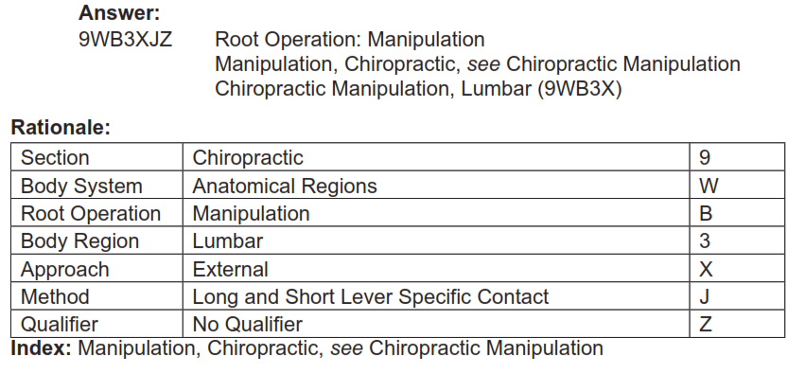
Answer

Slide 61
Ancillary Sections - Overview
Imaging
Nuclear Medicine
Radiation Therapy
Physical Rehabilitation and Diagnostic Audiology
Mental Health
Substance Abuse Treatment

Slide 62
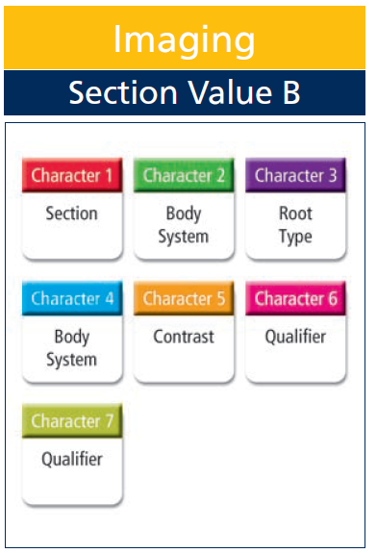
Imaging Section - B

Slide 63
Imaging Section - B
Character 1 | Character 2 | Character 3 | Character 4 | Character 5 | Character 6 | Character 7
Section | Body System | Root Type | Body Part | Contrast | Qualifier | Qualifier

Slide 64
Root Operations in Imaging
Computerized Tomography (CT)
Fluoroscopy
Magnetic Resonance Imaging (MRI)
Plain Radiography
Ultrasonography

Slide 65
Root Types of Imaging
Plain Radiography (value 0) – planar display of an image developed from the capture of external ionizing radiation on photographic or photoconductive plate.
Fluoroscopy (value 1) – single plane or bi-plane real time display of an image developed from the capture of external ionizing radiation on a fluorescent screen. The image may also be stored by either digital or analog means.

Slide 66
Root Types of Imaging
Computer Tomography (CT scan) (value 2) – computer reformatted digital display of multiplanar images developed from the capture of multiple exposures of external ionizing radiation.
Magnetic Resonance Imaging (MRI) (value 3) – computer reformatted digital display of multiplanar images developed from the capture of radio-frequency signals emitted by nuclei in a body site excited within a magnetic field.

Slide 67
Root Types of Imaging
Ultrasonography (value 4) – real-time display of images of anatomy or flow information developed from the capture of reflected and attenuated high frequency sound waves.

Slide 68
Quiz
MRI of thyroid gland, without contrast material followed by MRI with other contrast material.
Code(s): ________________

Slide 69
Answer

Slide 70
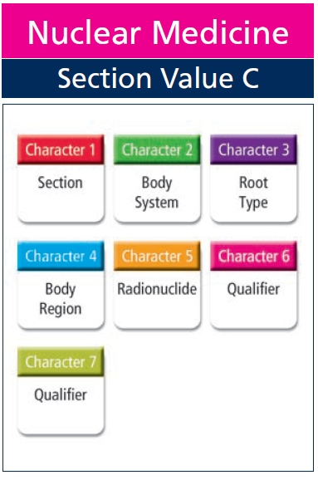
Nuclear Medicine - C

Slide 71
Nuclear Medicine
Character 1 | Character 2 | Character 3 | Character 4 | Character 5 | Character 6 | Character 7
Section | Body System | Root Type | Body Part | Radio- nuclide | Qualifier | Qualifier

Slide 72
Root Types in Nuclear Medicine
Nonimaging Nuclear Medicine Assay
Nonimaging Nuclear Medicine Probe
Nonimaging Nuclear Medicine Uptake
Planar Nuclear Medicine Imaging
Positron Emission Tomographic Imaging
Tomographic Nuclear Medicine Imaging

Slide 73
Root Types in Nuclear Medicine
Planar Nuclear Medicine Imaging (value 1) – Introduction of radioactive materials into the body for single plane display of images developed from the capture of radioactive emissions.
Tomographic (Tomo) Nuclear Medicine Imaging (value 2) – Introduction of radioactive materials into the body for three-dimensional display of images developed from the capture of radioactive emissions.

Slide 74
Root Types in Nuclear Medicine
Positron Emission Tomography (PET) (value 3) – Introduction of radioactive materials into the body for three-dimensional display of images developed from the simultaneous capture, 180 degrees apart, of radioactive emissions.
Nonimaging Nuclear Medicine Uptake (value 4) – Introduction of radioactive materials into the body for measurements of organ function, from the detection of radioactive emissions.

Slide 75
Root Types in Nuclear Medicine
Nonimaging Nuclear Medicine Probe (value 5) – Introduction of radioactive materials into the body for the study of distribution and fate of certain substances by the detection of radioactive emissions from an external source.
Nonimaging Nuclear Medicine Assay (value 6) – Introduction of radioactive materials into the body for the study of body fluids and blood elements, by the detection of radioactive emissions.

Slide 76
Root Types in Nuclear Medicine
Systemic Nuclear Medicine Therapy (value 7) – Introduction of unsealed radioactive materials into the body for treatment.

Slide 77
Quiz
PET scan of myocardium using Fluorine 18 (F-18).
Code(s): ________________

Slide 78
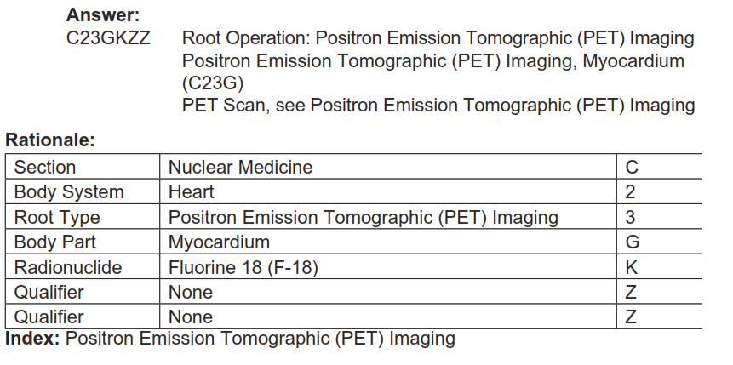
Answer

Slide 79
Quiz
Technetium tomo scan of the spleen.
Code(s): __________________

Slide 80
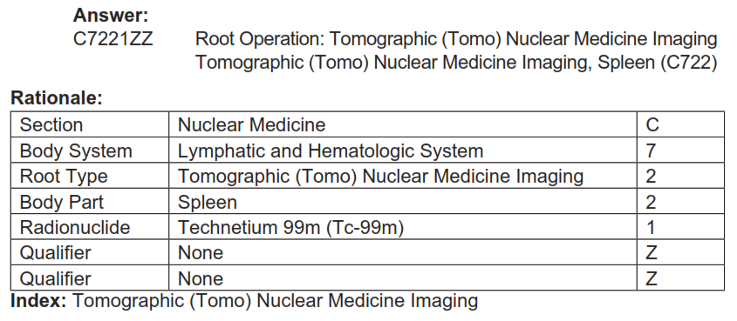
Answer

Slide 81
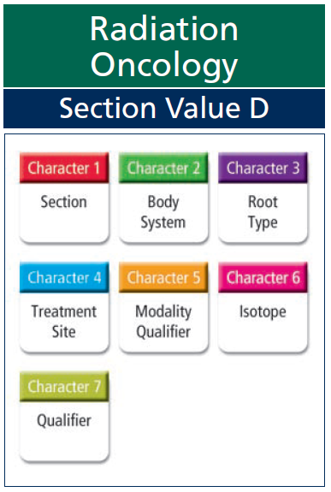
Radiation Therapy - D

Slide 82
Radiation Therapy - D
Character 1 | Character 2 | Character 3 | Character 4 | Character 5 | Character 6 | Character 7
Section | Body System | Root Type | Treatment Site | Modality Qualifier | Isotope | Qualifier

Slide 83
Root Types in Radiation Therapy
Beam Radiation
Brachytherapy
Stereotactic Radiosurgery
Other Radiation

Slide 84
What is Brachytherapy?
Brachytherapy is a cancer treatment in which radioactive material sealed inside a:
seed,
pellet,
wire, or
capsule
is implanted in the body using a needle or catheter.
The radiation given off by this source damages the DNA of nearby cancer cells.

Slide 85
What is Brachytherapy?
Brachytherapy is most commonly used to treat prostate cancer.
It also can be used for gynecologic cancers such as:
cervical cancer and uterine (endometrial) cancer,
breast cancer,
lung cancer,
rectal cancer,
eye cancer, and
skin cancer.

Slide 86
Quiz
Brachytherapy of prostate, HDR using Cesium 137.
Code(s): _________________

Slide 87
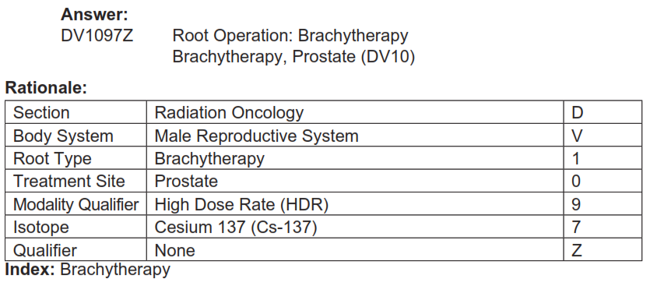
Answer

Slide 88
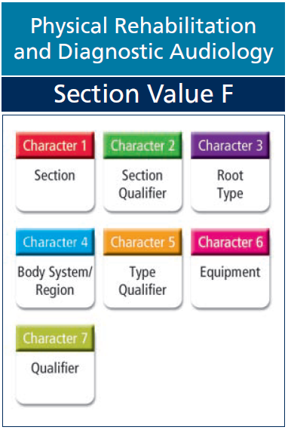
Physical Rehabilitation & Diagnostic Audiology

Slide 89
Physical Rehabilitation & Diagnostic Audiology - F
Character 1 | Character 2 | Character 3 | Character 4 | Character 5 | Character 6 | Character 7
Section | Section Qualifier | Root Type | Body System and Region | Type Qualifier | Equipment | Qualifier

Slide 90
Root Types in Physical Rehabilitation & Diagnostic Audiology
Activities of Daily Living Assessment
Activities of Daily Living Treatment
Caregiver Training
Cochlear Implant Treatment
Device Fitting
Hearing Aid Assessment
Hearing Assessment
Hearing Treatment
Motor and/or Nerve Function Assessment
Motor Treatment
Speech Assessment
Speech Treatment
Vestibular Treatment

Slide 91
Root Types in Physical Rehabilitation & Diagnostic Audiology
Speech Assessment (value 0) – Measurement of speech and related functions
Motor and/or Nerve Function Assessment (value 1) – Measurement of motor, nerve, and related functions
Activities of Daily Living Assessment (value 2) – Measurement of functional level for activities of daily living

Slide 92
Root Types in Physical Rehabilitation & Diagnostic Audiology
Hearing Assessment (value 3) – Measurement of hearing and related functions
Hearing Aid Assessment (value 4) – Measurement of the appropriateness and/or effectiveness of a hearing device
Vestibular Assessment (value 5) – Measurement of the vestibular system and related functions

Slide 93
Root Types in Physical Rehabilitation & Diagnostic Audiology
Speech Treatment (value 6) – Application of techniques to improve, augment or compensate for speech and related functional impairment
Motor Treatment (value 7) – Exercise or activities to increase or facilitate motor function
Activities of Daily Living Treatment (value 8) – Exercise or activities to facilitate functional competence for activities of daily living

Slide 94
Root Types in Physical Rehabilitation & Diagnostic Audiology
Hearing Treatment (value 9) – Application of techniques to improve, augment or compensate for hearing and related functional impairment
Hearing Aid Treatment (value B) – Application of techniques to improve the communication abilities of individuals with cochlear implant

Slide 95
Root Types in Physical Rehabilitation & Diagnostic Audiology
Vestibular Treatment (value C) – Application of techniques to improve, augment, or compensate for vestibular and related functional impairment
Device Fitting (value D) – Fitting of a device designed to facilitate or support achievement of a higher level of function
Caregiver Training (value F) – Training in activities to support patient’s optimal level of function

Slide 96
Physical Rehabilitation & Diagnostic Audiology
Coding Note: Treatment
Use of specific activities or methods to develop, improve, and/or restore the performance of necessary functions, compensate for dysfunction, and/or minimize debilitation
Treatment procedures include swallowing dysfunction exercises, bathing and showering techniques, wound management, gait training, and a host of activities typically associated with rehabilitation

Slide 97
Physical Rehabilitation & Diagnostic Audiology
Coding Note: Assessment
Assessment includes a determination of the patient’s diagnosis when appropriate, need for treatment, planning for treatment, periodic assessment, and documentation related to these activities.
Assessments are further classified into more than 100 different tests or methods.
The majority of these focus on the faculties of hearing and speech, but others focus on various aspects of body function, and on the patient’s qualify of life, such as muscle performance, neuromotor development, and reintegration skills.

Slide 98
Physical Rehabilitation & Diagnostic Audiology
Coding Note: Device Fitting
The fifth character used in Device Fitting procedures describes the device being fitted rather than the method used to fit the device.
Where definitions of devices are provided, they are located in the definitions portion of the ICD-10-PCS Tables and Index, under section F, character 5.

Slide 99
Physical Rehabilitation & Diagnostic Audiology
Coding Note: Caregiver Training
Educating caregivers with the skills and knowledge used to interact with and assist the patient.
Caregiver training is divided into 18 different broad subjects taught to help a caregiver provide proper patient care.

Slide 100
Quiz
Wound care treatment of right lower leg ulcer (staged to muscle) using pulsatile lavage.
Code(s): ________________

Slide 101
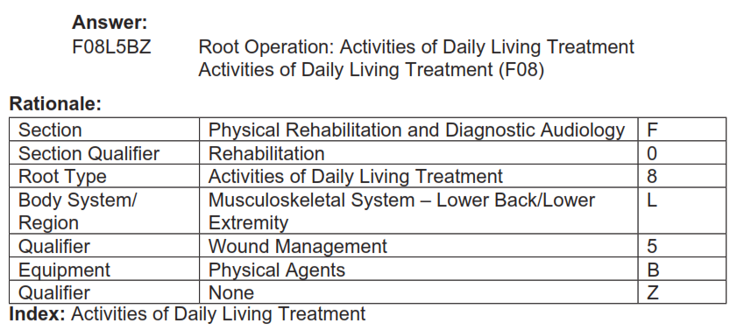
Answer

Slide 102
Quiz
Bekesy assessment using audiometer.
Code(s): __________________

Slide 103
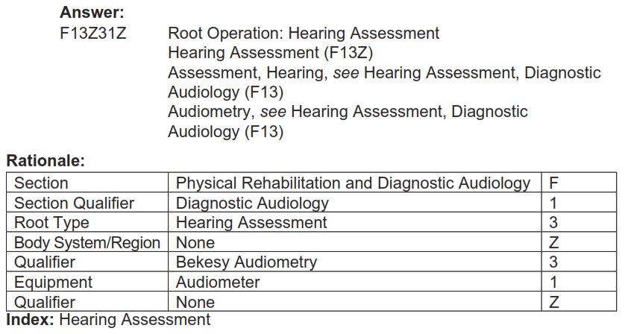
Answer

Slide 104
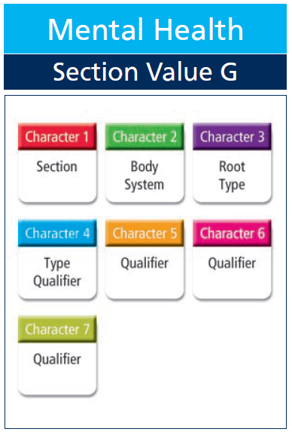
Mental Health - G

Slide 105
Mental Health - G
Character 1 | Character 2 | Character 3 | Character 4 | Character 5 | Character 6 | Character 7
Section | Body System | Root Type | Type Qualifier | Qualifier | Qualifier | Qualifier

Slide 106
Root Types in Mental Health
Biofeedback
Counseling
Crisis Intervention
Electroconvulsive Therapy
Family Psychotherapy
Group Psychotherapy
Hypnosis
Individual Psychotherapy
Light Therapy
Medication Management
Narcosynthesis
Psychological Tests

Slide 107
Quiz
Electroconvulsive therapy (ECT), bilateral, multiple seizures.
Code(s): _________________

Slide 108
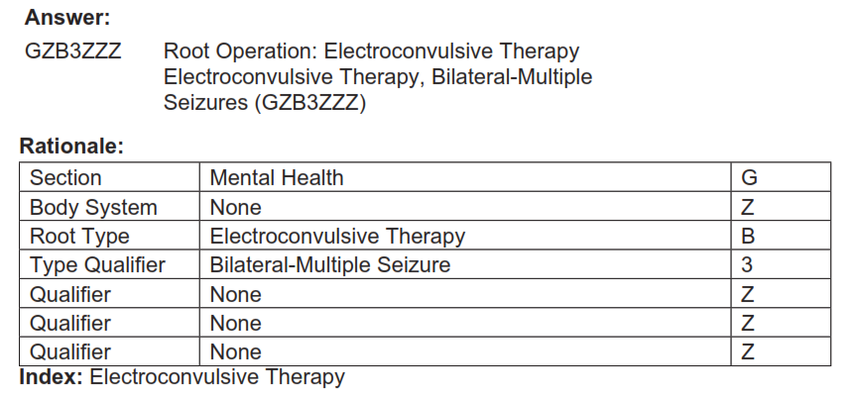
Answer

Slide 109
Quiz
Personality and Behavioral Testing.
Code(s): _________________

Slide 110
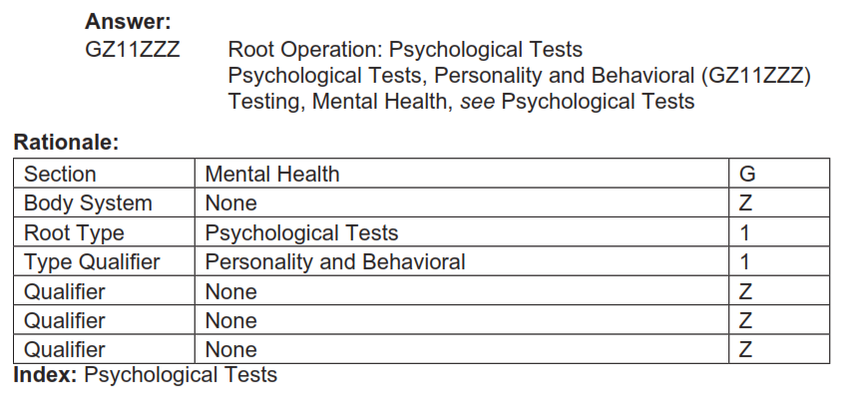
Answer

Slide 111
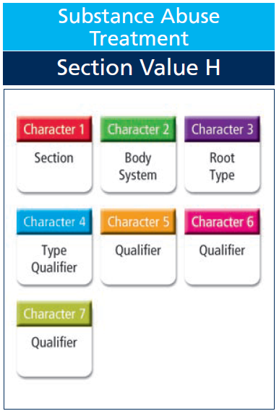
Substance Abuse Treatment - H

Slide 112
Substance Abuse Treatment - H
Character 1 | Character 2 | Character 3 | Character 4 | Character 5 | Character 6 | Character 7
Section | Body System | Root Type | Type Qualifier | Qualifier | Qualifier | Qualifier

Slide 113
Root Types in Substance Abuse
Detoxification Services
Family Counseling
Group Counseling
Individual Counseling
Individual Psychotherapy
Medication Management
Pharmacotherapy

Slide 114
Quiz
Alcohol detoxification treatment.
Code(s): _________________

Slide 115
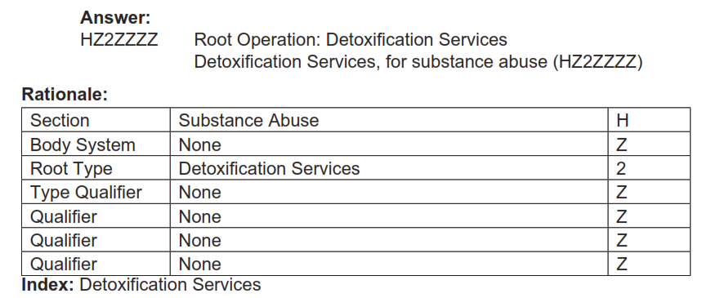
Answer

Slide 116
Quiz
Individual 12-step psychotherapy for substance abuse.
Code(s): ___________________

Slide 117
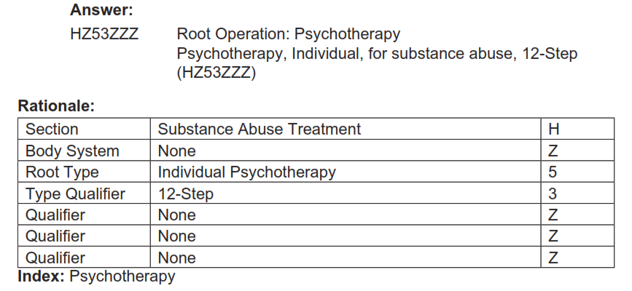
Answer

