Slide 1
ICD-10-PCS Training
Lamon Willis

Slide 2
Root Operations
Operations which take out Solids, Fluids, or Gases from a Body Part

Slide 3
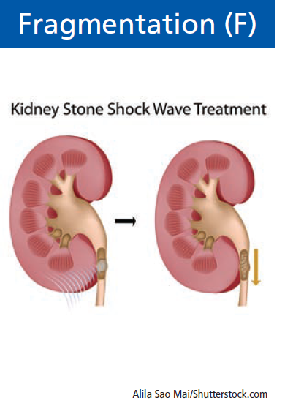
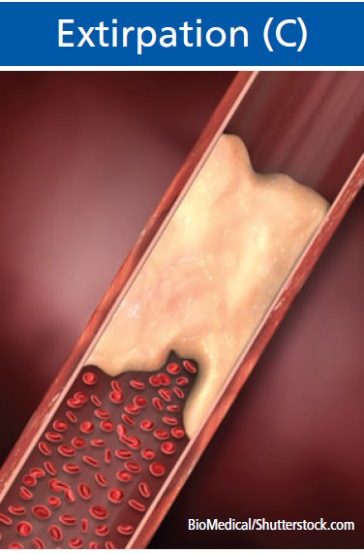
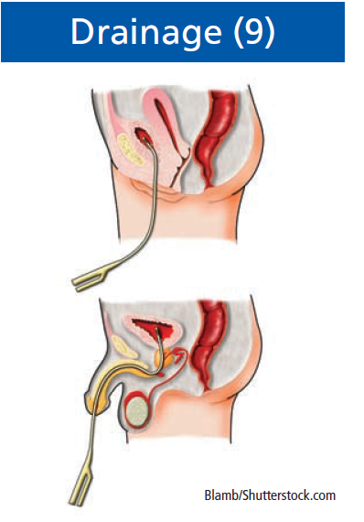
Root Operations
Operations which take out Solids, Fluids, or Gases from a Body Part

Slide 4
Drainage (9)
Drainage 9 | Definition | Taking or letting out fluids and/or gases from a body part
 | Explanation | The qualifier Diagnostic is used to identify drainage procedures that are biopsies
 | Examples | Thoracentesis, incision and drainage, Aspiration, Lumbar puncture
Used for both Diagnostic and Therapeutic procedures
6th character—Device
Notes:
The root operation Drainage is coded for both diagnostic and therapeutic drainage procedures. When drainage is accomplished by putting in a catheter, the device value Drainage Device is coded in the sixth character.

Slide 5
Extirpation (C)
Extirpation C | Definition | Taking or cutting out solid matter from a body part
 | Explanation | The solid matter may be an abnormal byproduct of a biological function or a foreign body; it may be imbedded in a body part, or in the lumen of a tubular body part. The solid matter may or may not have been previously broken into pieces.
 | Examples | Thrombectomy, endarterectomy, choledocholithotomy, excision foreign body

Slide 6
Extirpation
Extirpation represents a range of procedures where the body part itself is not the focus of the procedure.
Instead, the objective is to remove solid material such as a foreign body, thrombus, or calculus from the body part.

Slide 7
Fragmentation (F)
Fragmentation F | Definition | Breaking solid matter in a body part into pieces
 | Explanation | Physical force applied directly or indirectly is used to break the solid matter into pieces. The solid matter may be an abnormal byproduct of a biological function or a foreign body. The pieces of solid matter are not taken out.
 | Examples | Extracorporeal shockwave lithotripsy, transurethral lithotripsy
Notes:
Fragmentation is coded for procedures to break up, but not remove, solid material such as a calculus or foreign body. This root operation includes both direct and extracorporeal Fragmentation procedures.

Slide 8
Fragmentation (F)
Fragmentation is coded for procedures to break up, but not remove, solid material such as a calculus or foreign body.
This root operation includes both direct and extracorporeal Fragmentation procedures.

Slide 9
Quiz
The patient is being evaluated for septic arthritis of the right knee. A needle arthrocentesis was performed on the right knee with 15 cc of fluid being removed.
Code(s):______________________

Slide 10
Quiz
The patient is being evaluated for septic arthritis of the right knee. A needle arthrocentesis was performed on the right knee with 15 cc of fluid being removed.
Code(s):______________________

Slide 11
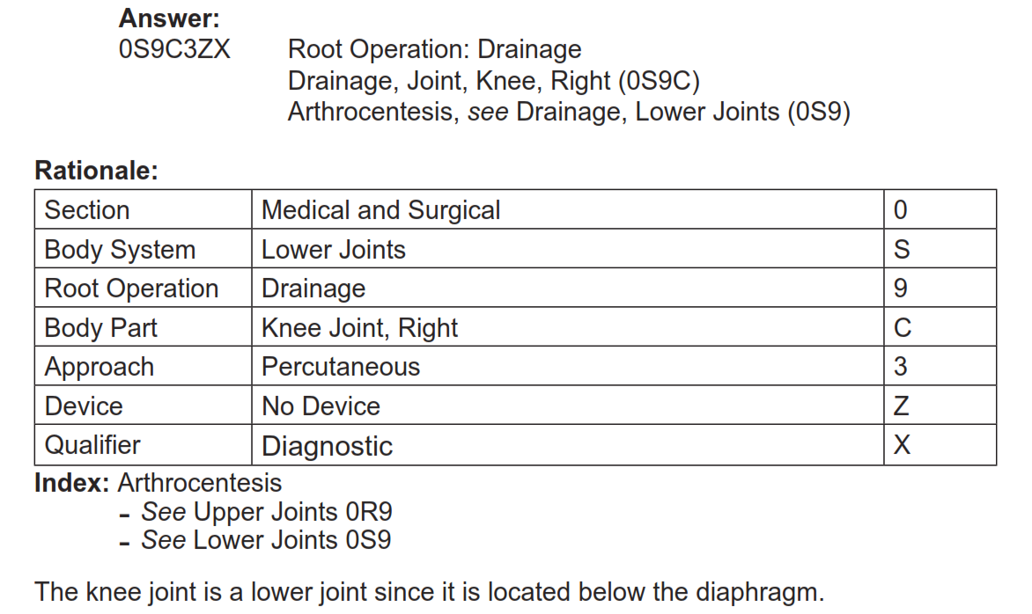
Answer

Slide 12
Quiz
A staghorn calculus of the right renal pelvis was treated five days ago by lithotripsy. During this encounter the calculus pieces are removed via a percutaneous nephrostomy tube.
Code(s): ______________________

Slide 13
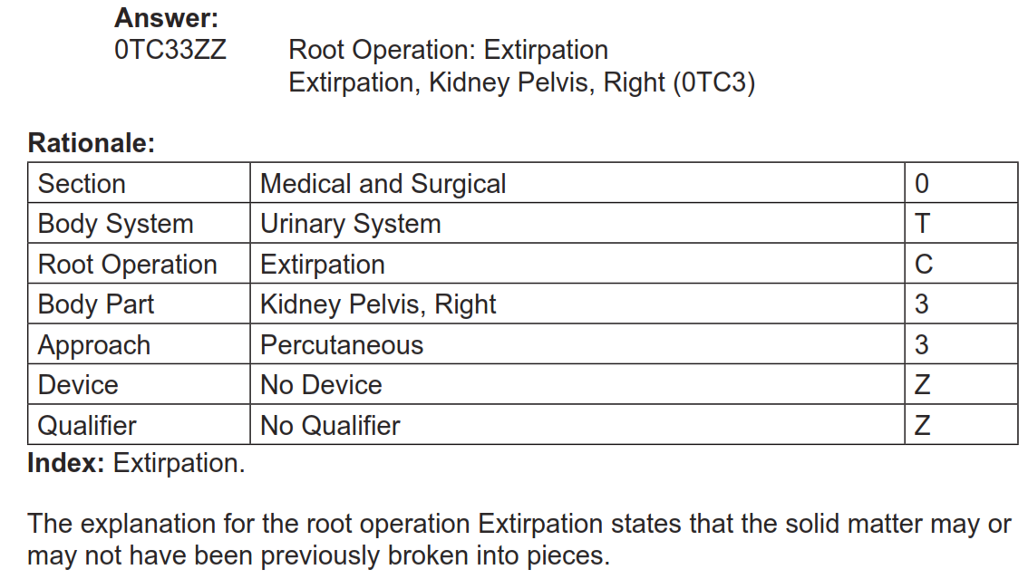
Answer

Slide 14
Quiz
The patient was placed in the supine position and in the F2 focus of the MSL 5000 lithotriptor. Shock wave lithotripsy was begun at 17 kV and progressed to 23. A total of 3,000 shocks were given to the stone with resultant fragmentation of the calculus in the left renal pelvis.
Code(s): __________________

Slide 15
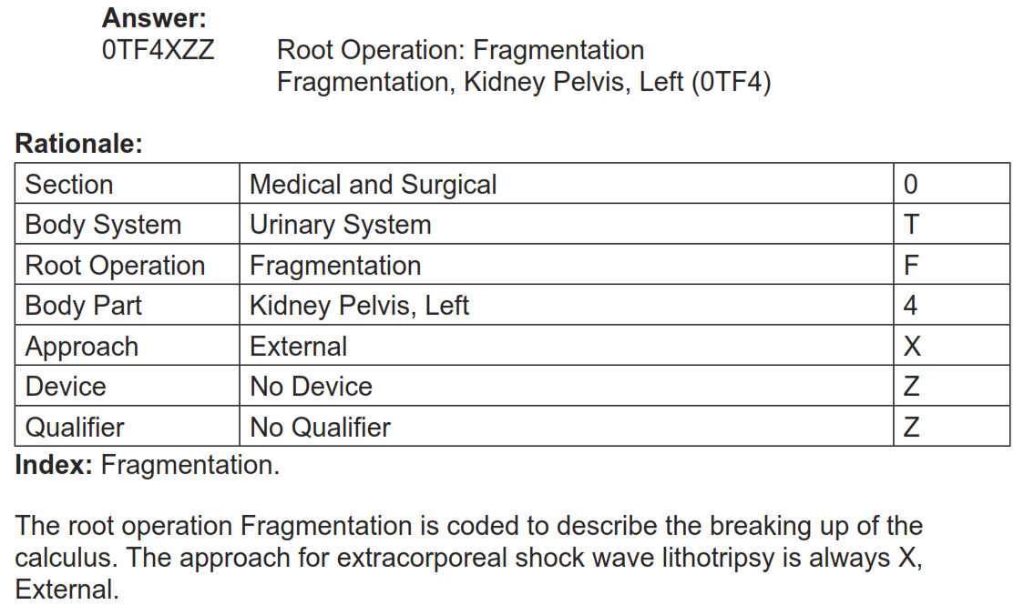
Answer

Slide 16
Root Operations
Operations Involving Cutting or Separation Only

Slide 17
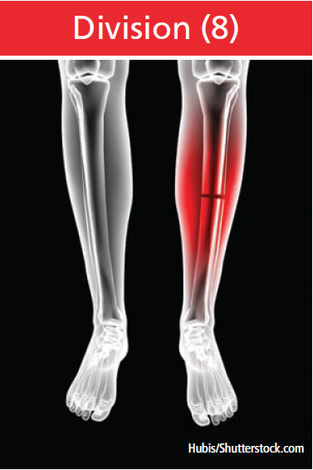
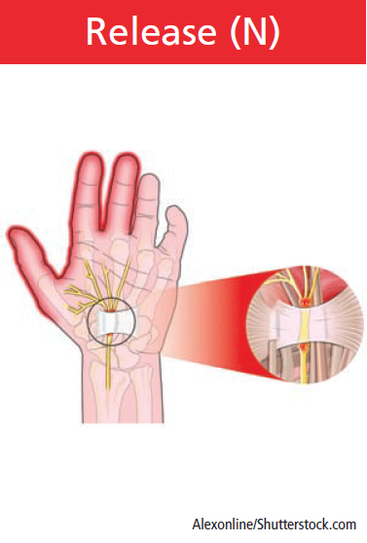
Root Operations
Operations Involving Cutting or Separation Only

Slide 18
Division (8)
Division 8 | Definition | Cutting into a body part without draining fluids and/or gases from the body part in order to separate or transect a body part
 | Explanation | All or a portion of the body part is separated into two or more portions
 | Examples | Spinal cordotomy, osteotomy, neurotomy, episiotomy
.

Slide 19
Division (8)
The root operation Division is coded when the objective of the procedure is to cut into, transect, or otherwise separate all or a portion of a body part.
When the objective is to cut or separate the area around a body part, the attachments to a body part, or between subdivisions of a body part that are causing abnormal constraint, the root operation Release is coded instead.

Slide 20
Division
Cut the body part
Release
Free the body part

Slide 21
Division (8) versus Release (N)
Coding Guideline B3.14. Release vs. Division
If the sole objective of the procedure is freeing a body part without cutting the body part, the root operation is Release.
If the sole objective of the procedure is separating or transecting a body part, the root operation is Division.

Slide 22
Division (8) versus Release (N)
Coding Guideline B3.14. Release vs. Division
Examples:
Freeing a nerve root from surrounding scar tissue to relieve pain is coded to the root operation Release.
Severing a nerve root to relieve pain is coded to the root operation Division.

Slide 23
Release (N)
Release N | Definition | Freeing a body part from an abnormal physical constraint by cutting or by use of force
 | Explanation | Some of the restraining tissue may be taken out but none of the body part is taken out
 | Examples | Adhesiolysis, carpal tunnel release, manipulation of joint adhesions

Slide 24
Release (N)
Release procedures are coded to the body part being freed.
The procedure can be performed:
on the area around a body part,
on the attachments to a body part, or
between subdivisions of a body part that are causing the abnormal constraint.

Slide 25
Release (N)
Coding Guideline B3.13. Release Procedures
In the root operation Release, the body part value coded is the body part being freed and not the tissue being manipulated or cut to free the body part.
Example:
Lysis of intestinal adhesions is coded to the specific intestine body part value.

Slide 26
Quiz
A patient is being treated for a cumulative injury resulting in a frozen left shoulder. The patient has been unresponsive to exercise and medication. An arthroscopic manipulation is performed to release the frozen shoulder.
Code(s): _______________

Slide 27
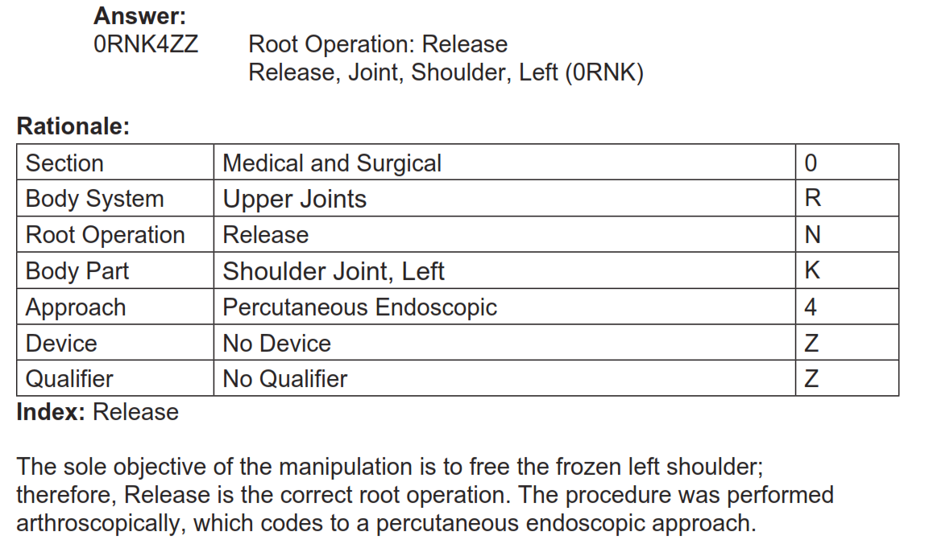
Answer

Slide 28
Quiz
The patient has bilateral flexion contractures of the knees at 45 degrees. Posterior capsulotomy via incision was performed on both knees.
Code(s): ____________________________

Slide 29
Answer

Slide 30
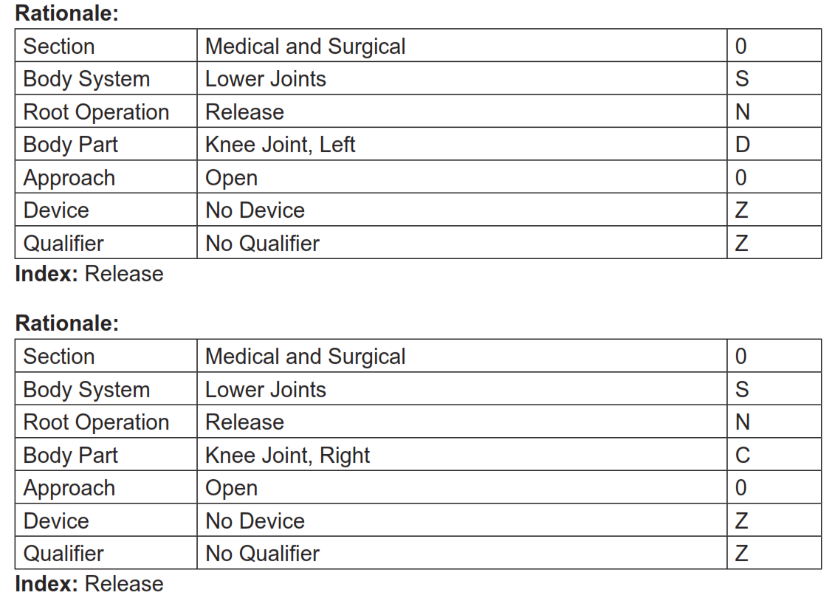
Answer

Slide 31
Quiz
In preparation for an impending delivery, the physician performs a midline episiotomy.
Code(s): __________________

Slide 32
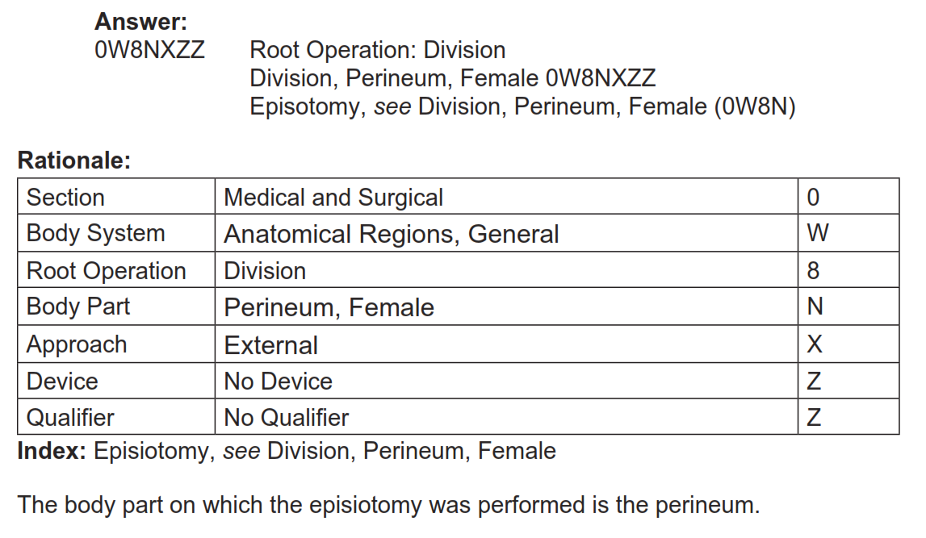
Answer

Slide 33
Quiz
Percutaneous osteotomy of the capitate and lunate bones, right hand.
Code(s): ______________________________

Slide 34
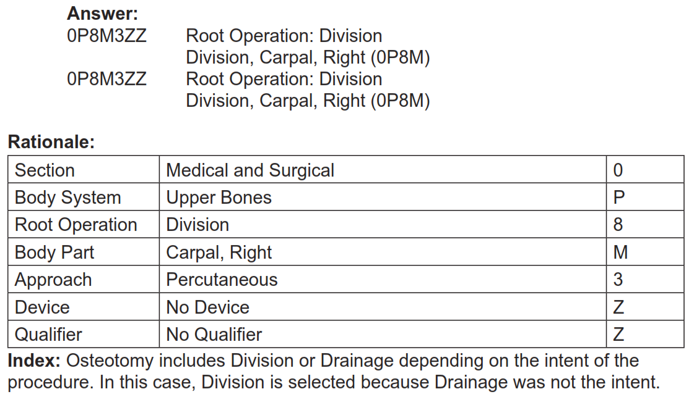
Answer

Slide 35
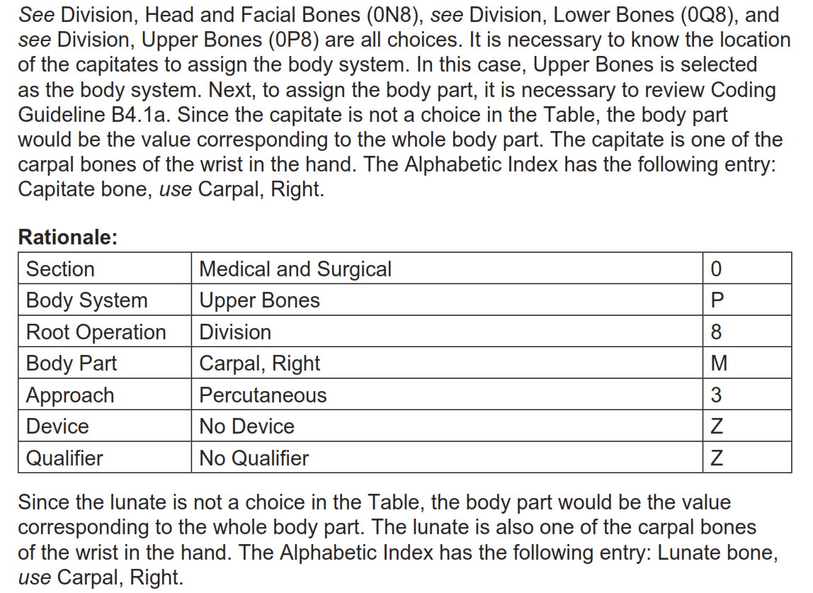
Answer

Slide 36
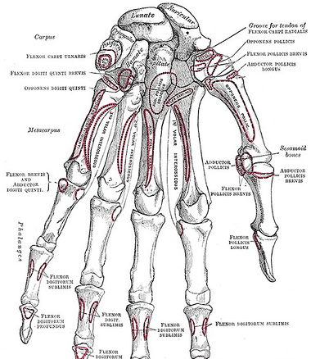
Knowledge of anatomy and diagrams are keys to successful PCS coding.

Slide 37
Root Operations
Operations That Put In/ Put Back or Move Some/All of a Body Part

Slide 38
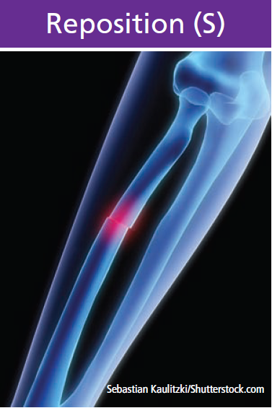
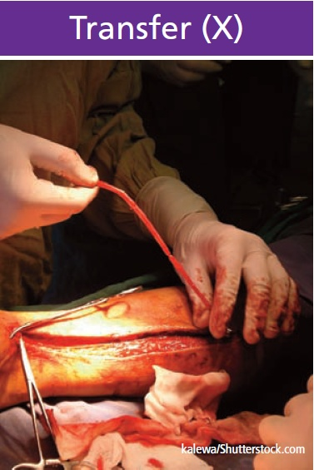
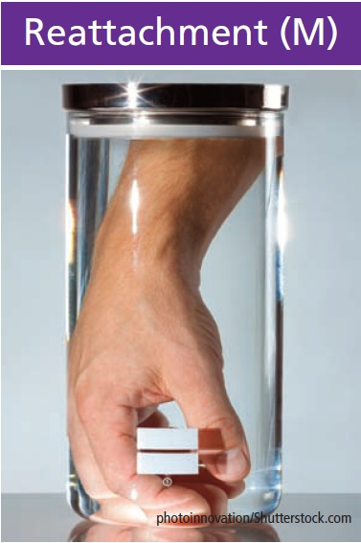
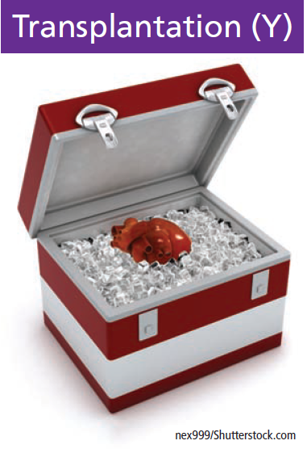
Root Operations
Operations That Put In/ Put Back or Move Some/All of a Body Part

Slide 39
Transplantation (Y)
Transplantation Y | Definition | Putting in or on all or a portion of a living body part taken from another individual or animal to physically take the place and/or function of all or a portion of a similar body part
 | Explanation | The native body part may or may not be taken out, and the transplanted body part may take over all or a portion of its function
 | Examples | Kidney transplant, heart transplant

Slide 40
Transplantation (Y)
A small number of procedures is represented in the root operation Transplantation and includes only the body parts currently being transplanted.
Go to Transplantation in Index
Cornea and heart valve go to Replacement
Bone marrow transplant goes to Administration Section
Qualifier values specify the genetic compatibility of the body part transplanted

Slide 41
Transplantation (Y)
Coding Note: Bone Marrow Transplant
Bone marrow transplant procedures are coded in section 3, Administration, to the root operation 2, Transfusion

Slide 42
Qualifier Values for Transplantation
Allogeneic
Syngeneic
Zooplastic

Slide 43
Qualifier Choices
Type of Transplant | Qualifier Character | Definition
Allogeneic | 0 | Taken from different individuals of the same species
Syngeneic | 1 | Having to do with individuals or tissues that have identical genes, such as identical twins
Zooplastic | 2 | Tissue from an animal to a human

Slide 44
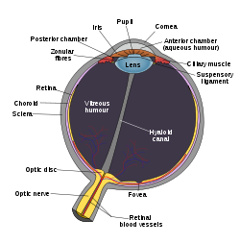
Coding Tip
PCS does not include corneas and heart valves in the root operation Transplantation.
Even though sometimes referred to as a transplant, the cornea graft is a layer of corneal tissue and not considered a body part in the same way that complex structures like lung, liver, and kidney are.
Corneas and heart valves are classified to Replacement in PCS.

Slide 45
Transplantation (Y)
Coding Guideline B3.16. Transplantation vs. Administration
Putting in a mature and functioning living body part taken from another individual or animal is coded to the root operation Transplantation. Putting in autologous or nonautologous cells is coded to the Administration section.
Example: Putting in autologous or nonautologous bone marrow, pancreatic islet cells, or stem cells is coded to the Administration section.

Slide 46
Reattachment (M)
Reattachment M | Definition | Putting back in or on all or a portion of a separated body part to its normal location or other suitable location
 | Explanation | Vascular circulation and nervous pathways may or may not be reestablished
 | Examples | Reattachment of hand, reattachment of avulsed kidney, reattachment of finger

Slide 47
Reattachment (M)
Procedures coded to Reattachment include putting back a body part that has been cut off or avulsed.
Nerves and blood vessels may or may not be reconnected in a Reattachment procedure.
Coding Note: Free grafts are coded to the root operation of Replacement.

Slide 48
Transfer (X)
Transfer X | Definition | Moving, without taking out, all or a portion of a body part to another location to take over the function of all or a portion of a body part
 | Explanation | The body part transferred remains connected to its vascular and nervous supply
 | Examples | Tendon transfer, skin pedicle flap transfer, skin transfer flap

Slide 49
Transfer (X)
Coding Note: Body System Value
For procedures involving transfer of tissue layers such as skin, fascia and muscle, the procedure is coded to the body system value that describes the deepest tissue layer in the flap. When the tissue transferred is composed of more than one tissue layer, the qualifier can be used to describe the other tissue layers, if any, being transferred.
For transfer procedures classified to other body systems such as peripheral nervous system, the body part value specifies the body part that is the source of the transfer ("from"). Where qualifiers are available, they specify the destination of the transfer ("to").

Slide 50
Transfer (X)
The root operation Transfer is used to represent procedures where a body part is moved to another location without disrupting its vascular and nervous supply. In the body systems that classify the subcutaneous tissue, fascia, and muscle body parts, a qualifier is used to specify when more than one tissue layer was used in the transfer procedure, such as musculocutaneus flap transfer.
Coding Note: Free grafts are coded to the root operation of Replacement

Slide 51
Reposition (S)
Reposition S | Definition | Moving to its normal location or other suitable location all or a portion of a body part
 | Explanation | The body part is moved to a new location from an abnormal location, or from a normal location where it is not functioning correctly. The body part may or may not be cut out or off to be moved to the new location
 | Examples | Reposition of undescended testicle, fracture reduction

Slide 52
Reposition (S)
Reposition represents procedures for moving a body part to a new location.
The range of Reposition procedures includes moving a body part to its normal location, or moving a body part to a new location to enhance its ability to function.

Slide 53
Reposition (S)
Reduction of displaced fracture = Reposition
Application of cast/splint in conjunction with Reposition procedure is NOT coded separately
Nondisplaced fracture coding examples:
Putting in a pin = Insertion
Casting = Immobilization (Placement section)

Slide 54
Reposition (S)
Coding Note: The diagnosis code in ICD-10-CM would reflect that a displaced fracture is being reduced when the root operation of Reposition is used.

Slide 55
Quiz
A 20-year-old patient with cystic fibrosis is admitted for a double lung transplant from a cadaver donor.
Code(s): ________________

Slide 56
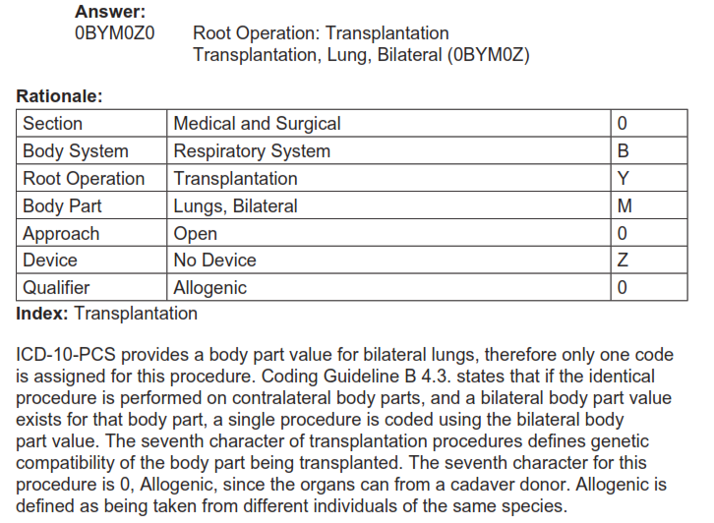
Answer

Slide 57
Quiz
The patient undergoes nerve surgery to prevent a residual claw-hand injury after injuring his left hand. An anterior interosseous to ulnar nerve graft is accomplished via incision using an operative microscope and the interosseous and ulnar nerve are brought together without dissection.
Code(s): ___________________

Slide 58
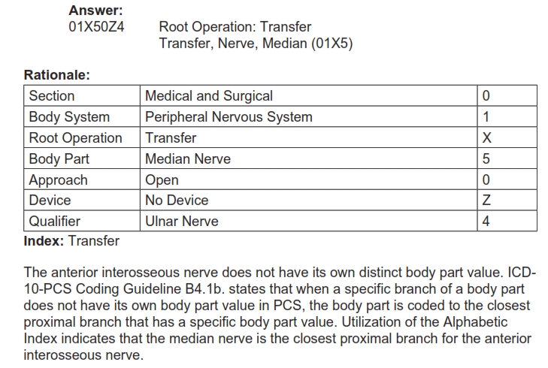
Answer

Slide 59
Quiz
The patient was involved in a farm injury and his left arm was severed to the elbow. The arm was reconnected, with full revascularization and nerve attachment.
Code(s): __________________

Slide 60
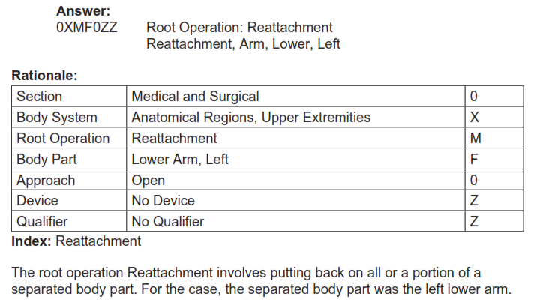
Answer

