Slide 1
Outpatient Spinal Surgery Procedures
Lamon Willis

Slide 2
Notes:
Spine Anatomy Video

Slide 3
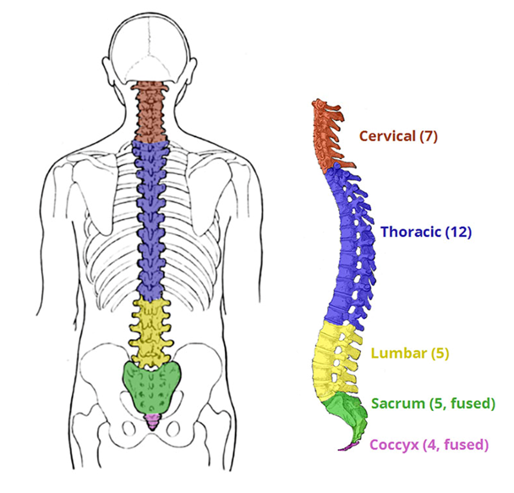
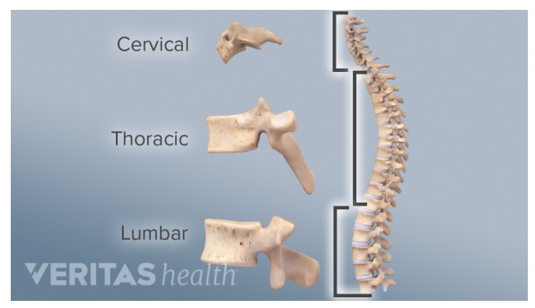
Anatomy Involved

Slide 4
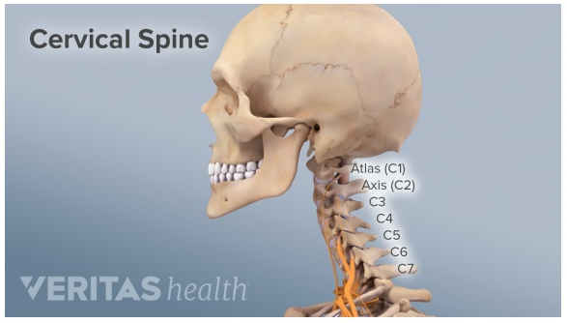
Anatomy Involved

Slide 5
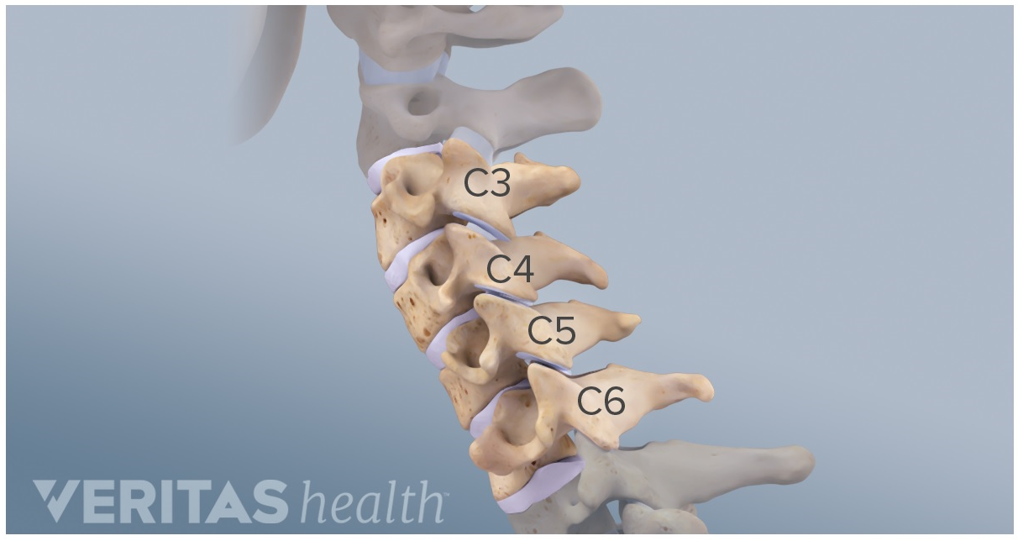
Anatomy Involved

Slide 6
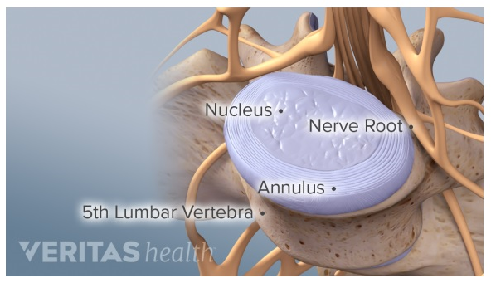
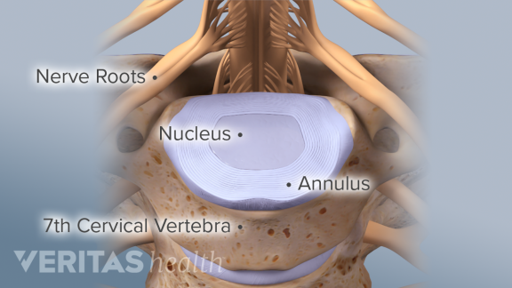
Anatomy Involved

Slide 7
Anatomy Involved

Slide 8
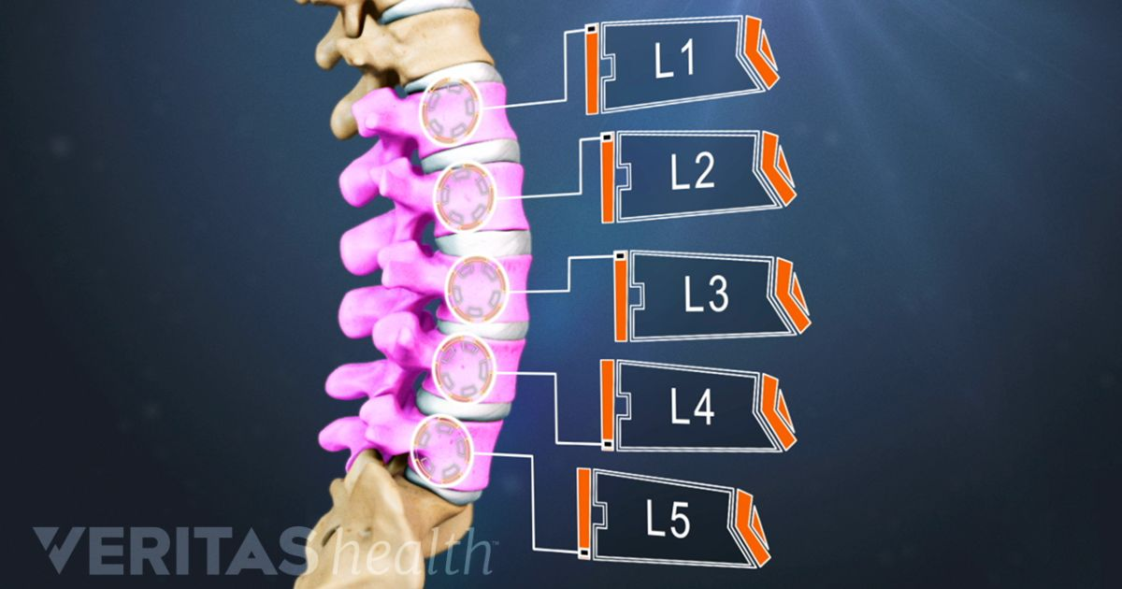
Anatomy Involved

Slide 9
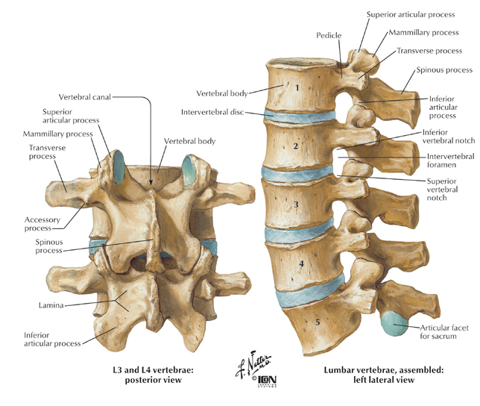
Anatomy Involved

Slide 10
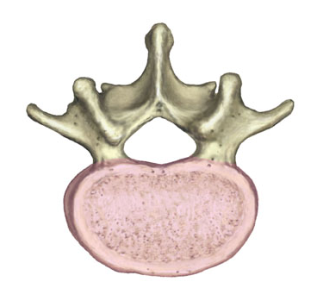
Anatomy Involved
Posterior/Dorsal
Vertebral Body
Anterior/Ventral

Slide 11
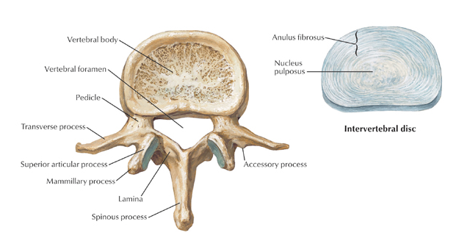
Anatomy Involved

Slide 12
Anatomy Involved

Slide 13
Anatomy Involved

Slide 14
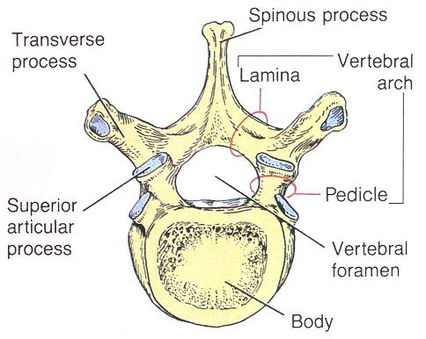
Anatomy Involved

Slide 15
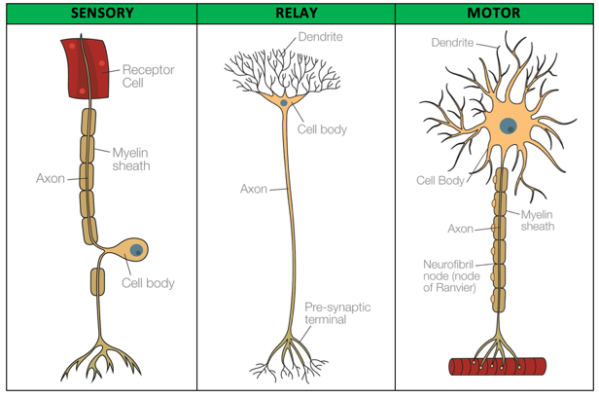
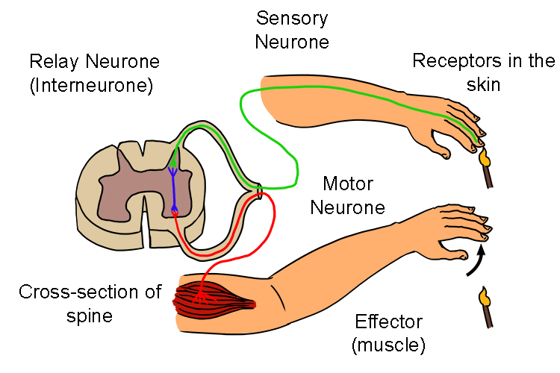
Anatomy Involved
Sensory or Afferent neurons carry signals from the outer parts of your body (periphery) into the central nervous system.
Motor or Efferent neurons (motoneurons) carry signals from the central nervous system to the outer parts (muscles, skin, glands) of your body. Interneurons connect various neurons within the brain and spinal cord.
Notes:
Think of Afferent as those which the brain Accepts signals for, and the Efferent as those signals which Exit the brain.

Slide 16
Common Disorders of Spine
Back and Neck Pain
Herniated Discs, Lumbar & Cervical
Degenerative Disc Disease
Pinched Nerve
Spinal Stenosis
Scoliosis
Spondylolisthesis
Spinal Fractures
Spinal Cord Injuries
Notes:
A herniated disc is a cause of back and leg pain. Tom Merton / Getty Images. Many patients with back pain, leg pain, or weakness of the lower extremity muscles are diagnosed with a herniated disc. When a disc herniation occurs, the cushion that sits between the spinal vertebra is pushed outside its normal position.
Degenerative disk disease is when normal changes that take place in the disks of your spine cause pain. Spinal disks are like shock absorbers between the vertebrae, or bones, of your spine. They help your back stay flexible, so you can bend and twist. As you get older, they can show signs of wear and tear.
A pinched nerve can occur at a number of sites in your body. A herniated disk in your lower spine, for example, may put pressure on a nerve root, causing pain that radiates down the back of your leg. Likewise, a pinched nerve in your wrist can lead to pain and numbness in your hand and fingers (carpal tunnel syndrome).
Spinal stenosis (or narrowing) is a common condition that occurs when the small spinal canal, which contains the nerve roots and spinal cord, becomes compressed. This causes a “pinching” of the spinal cord and/or nerve roots, which leads to pain, cramping, weakness or numbness.
Scoliosis is a sideways curvature of the spine that occurs most often during the growth spurt just before puberty. While scoliosis can be caused by conditions such as cerebral palsy and muscular dystrophy, the cause of most scoliosis is unknown.
Spondylolisthesis is a slipping of vertebra that occurs, in most cases, at the base of the spine. Spondylolysis, which is a defect or fracture of one or both wing-shaped parts of a vertebra, can result in vertebrae slipping backward, forward, or over a bone below.

Slide 17
Principles of Spine Procedure Coding
Bone Graft
Allograft vs. Autograft Morselized vs. Structural
Instrumentation
Location:
anterior vs. posterior vs. intervertebral
There are many “inpatient only” procedures which would not be coded by OP coding staff related to spinal surgery coding.
Arthrodesis
Approach: anterior vs. posterior vs.
lateral extracavitary vs. pre-sacral
Region: cervical vs. thoracic vs. lumbar
Decompression (e.g., laminectomy, discectomy, corpectomy, spine fracture repair)
Approach: anterior vs. posterior vs. lateral extracavitary
Region: cervical vs. thoracic vs. lumbar

Slide 18
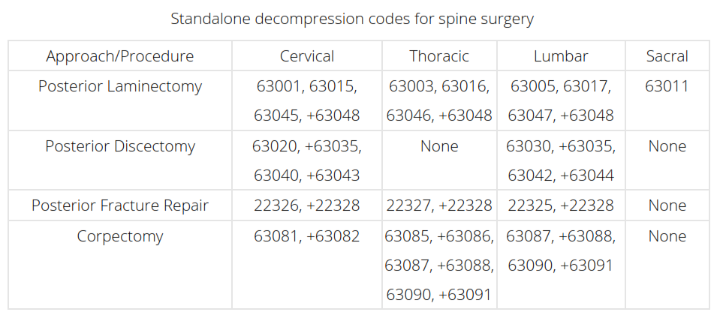
Five Principles for Spine Coding
1. Choose standalone codes to describe decompression/discectomy
Notes:
Decompression is the general term to describe removal of the spinal disk, bone, or tissue causing pressure and pain. Often, this is the only procedure performed. Examples include: laminectomy to decompress spinal canal and/or nerve roots (e.g., 63001-63017, 63045-+63048), discectomy to decompress spinal canal and/or nerve roots (e.g., 63020-+63035, 63040-+63044, 63055-+63057), corpectomy (e.g., 63081-+63091), fracture repair (e.g., 22325-+22328), etc.
CPT® designates the decompression codes as being per “vertebral segment” or per “interspace.” Decompression occurs at the interspace for discectomy codes (e.g., right L4-L5 interspace). Discectomy is a single, standalone code, such as 63030 Laminotomy (hemilaminectomy), with decompression of nerve root(s), including partial facetectomy, foraminotomy and/or excision of herniated intervertebral disc; 1 interspace, lumbar.
But decompression of the spinal canal can be coded per vertebral segment (63001-63017), or per level of foraminotomy (e.g., decompression of the L4 exiting nerve root via partial laminectomy at L4 and partial laminectomy at L5, with foraminotomy at L4-L5, is reported using one code: 63047 Laminectomy, facetectomy and foraminotomy (unilateral or bilateral with decompression of spinal cord, cauda equina and/or nerve root[s], [eg, spinal or lateral recess stenosis]), single vertebral segment; lumbar).
Discern whether the approach was posterior or anterior to choose the correct code. This table illustrates commonly used, standalone decompression codes for spine surgery.
From the operative note, identify which decompression/discectomy activity the surgeon performed. Then, choose an appropriate standalone code and any associated add-on codes (noted by the “+” sign in CPT®) for the decompression. Remember, corpectomy (removal of part or all of a vertebral body) codes include the discectomy at the level above and below the corpectomy. Documentation also should reflect removal of at least 50 percent of the cervical vertebral body, or 33 percent of the thoracic and lumbar vertebral bodies, to use the corpectomy codes.
Example 1
A 68-year-old male who has lumbar spinal stenosis at L5-S1 undergoes partial laminectomies at L5 and S1, with medial facetectomy and foraminotomy at L5-S1. This is reported with 63047.
Example 2
A 33-year-old female herniates an intervertebral disc on the right at L4-L5 while lifting her 4-year-old child. She undergoes minimally invasive hemi-laminotomies and foraminotomy with discectomy at L4-L5 on the right side. This is reported with 63030.

Slide 19
Five Principles for Spine Coding
2. Was a fusion (arthrodesis) performed?
If the answer is “no,” go to principle No. 5.
If the answer is “yes,” choose the standalone CPT for the fusion (synonymous with “arthrodesis,” or the joining of two or more vertebrae).
Fusion is the merging of adjacent parts; therefore, coding a single fusion segment (22612 Arthrodesis, posterior or posterolateral technique, single level; lumbar (with lateral transverse technique, when performed)) involves two adjacent vertebral segments (L4 and L5).
Notes:
Be careful: There is a single combined decompression/fusion code: 22551 Arthrodesis, anterior interbody, including disc space preparation, discectomy, osteophytectomy and decompression of spinal cord and/or nerve roots; cervical below C2. Do not use a separate standalone anterior cervical arthrodesis code (22554 Arthrodesis, anterior interbody technique, including minimal discectomy to prepare interspace (other than for decompression); cervical below C2) with the separate anterior cervical discectomy/decompression code (63075 Discectomy, anterior, with decompression of spinal cord and/or nerve root(s), including osteophytectomy; cervical, single interspace) at the same spinal level. Use the combined decompression/arthrodesis code, 22551, instead.
Discern whether the approach was posterior or anterior to choose the correct arthrodesis code(s). The standalone code covers the first segment of fusion, and the associated add-on codes are used for additional levels of fusion. For example, a posterior fusion at L4-S1 is coded as 22612 (L4-L5) and +22614 Arthrodesis, posterior or posterolateral technique, single level; each additional vertebral segment (List separately in addition to code for primary procedure) (L5-S1), not 22612 (L4), +22614 (L5), and +22614 (S1). See the commonly used arthrodesis codes in spine surgery.

Slide 20
Five Principles for Spine Coding

Slide 21
Five Principles for Spine Coding
3. Choose the appropriate add-on bone graft code with fusion.
Notes:
Because a fusion was performed, you must include a bone graft code. As with other graft codes in CPT®, the spinal bone graft codes are reported for harvesting the bone graft. The work of placing the bone graft is included in the arthrodesis/fusion codes.
All spinal bone graft codes are add-on codes. Choosing one is easy: There are only five, as shown in this table, CPT guidelines allow for reporting each bone graft code once per operative session.
From the operative note, determine whether the bone graft was an allograft or an autograft, and whether it was a morselized (bits or pieces) or structural (wedge or chunk) bone. It helps to know what the bone type documented in the operative note looks like.
Examples of +20930 Allograft, morselized, or placement of osteopromotive material, for spine surgery only (List separately in addition to code for primary procedure) include demineralized bone matrix (DBM or DBX) and bone morphogenic protein (BMP). Examples of +20931 Allograft, structural, for spine surgery only (List separately in addition to code for primary procedure) include a fibular strut graft and a machine threaded bone dowel.
Examples of +20936 Autograft for spine surgery only (includes harvesting the graft); local (eg, ribs, spinous process, or laminar fragments) obtained from same incision (List separately in addition to code for primary procedure) include crushed spinous process and/or lamina bone or rib harvested through the same exposure. An example of +20937 Autograft for spine surgery only (includes harvesting the graft); morselized (through separate skin or fascial incision) (List separately in addition to code for primary procedure) is cancellous iliac crest bone; +20938 Autograft for spine surgery only (includes harvesting the graft); structural, bicortical or tricortical (through separate skin or fascial incision) (List separately in addition to code for primary procedure)is bicortical or tricortical iliac crest bone.

Slide 22
Five Principles for Spine Coding
4. Was instrumentation used in the fusion?
If the answer is “no,” go to principle No. 5.
If the answer is “yes,” choose the appropriate add-on code(s) for the instrumentation, also known as hardware.
Review the operative note to determine where the instrument was used, and whether it was non-segmental, segmental, or intervertebral.
Notes:
Posterior instrumentation is categorized as non-segmental or segmental. Non-segmental instrumentation (+22840 Posterior non-segmental instrumentation (eg, Harrington rod technique, pedicle fixation across 1 interspace, atlantoaxial transarticular screw fixation, sublaminar wiring at C1, facet screw fixation) (List separately in addition to code for primary procedure)) is defined by CPT® as “fixation at each end of the construct and may span several vertebral segments without attachment to the intervening segments.” In plain language, this means the instrumentation has only two points of attachment on the spine: at the top and at the bottom of the construct. For example, this may be by pedicle screws and rods at L4-L5 only, or a long rod attached at T2 and extended to the second point of attachment at L5.
CPT® defines segmental instrumentation (+22842-+22844) as “fixation at each end of the construct and at least one additional interposed bony attachment,” meaning at least three points of attachment on the spine. Examples include pedicle screws and rods at L4, L5, and S1.
Choose anterior instrumentation codes (+22845-+22847) based on the number of vertebral segments the hardware (typically, a plate) spans. For example, report a plate attached to C5, C6, and C7 (three vertebral segments) that spans two interspaces (C5-C6, C6-C7) with +22845 Anterior instrumentation; 2 to 3 vertebral segments (List separately in addition to code for primary procedure).
Intervertebral instrumentation (+22851 Application of intervertebral biomechanical device(s) (eg, synthetic cage(s), methylmethacrylate) to vertebral defect or interspace (List separately in addition to code for primary procedure)) is any synthetic device, not considered a bone graft, which is put into the interspace or vertebral defect to promote fusion. These devices are typically made of titanium or polyether ether ketone (PEEK). Report +22851 per interspace, or per vertebral defect, not by how many devices are placed in the interspace. For example, two small PEEK devices placed at L4-L5 are reported with a single unit of +22851.

Slide 23
Five Principles for Spine Coding

Slide 24
Five Principles for Spine Coding
5. Were other procedures performed in addition to decompression?
If the answer is “no,” your coding is complete.
If the answer is “yes,” code for the other procedures.
Examples include:
Use of an operating microscope for microdissection (+69990 Microsurgical techniques, requiring use of operating microscope (List separately in addition to code for primary procedure))

Slide 25
Five Principles for Spine Coding
Bone marrow harvest in a separate surgical exposure such as from the iliac crest, for the autograft (38220 Bone marrow; aspiration only)
Use of a stereotactic navigation system for pedicle screw placement (+61783 Stereotactic computer-assisted (navigational) procedure; spinal (List separately in addition to code for primary procedure))

Slide 26
Principles of Spine Procedure Coding
Any other procedures performed? Examples:
Microdissection (+69990)
Stereotactic navigational planning (+61783)
Bone marrow aspirate (38220) through a separate needle puncture site (e.g., via iliac crest for cervical procedure) or documented separate skin/fascial incision

Slide 27
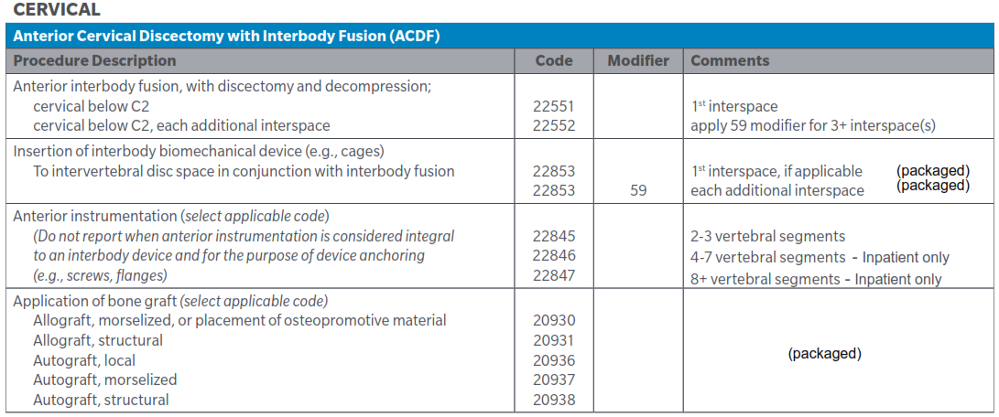
Cervical Spinal Procedures

Slide 28
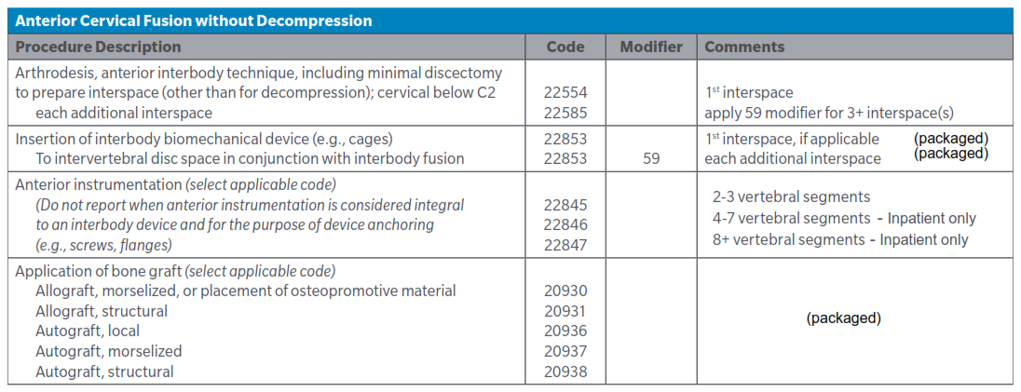
Cervical Spinal Procedures

Slide 29
Cervical Spinal Procedures

Slide 30
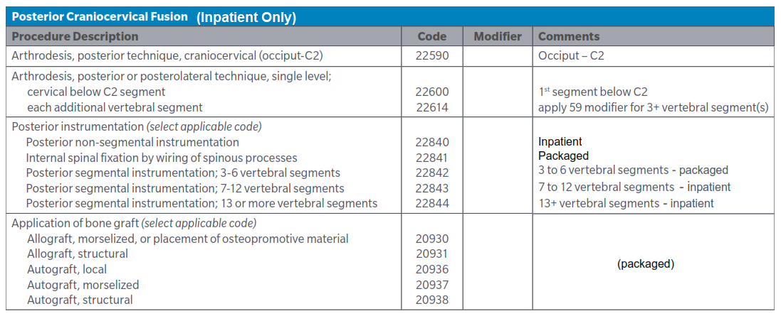
Cervical Spinal Procedures

Slide 31
Cervical Spinal Procedures

Slide 32
Example

Slide 33
Example

Slide 34
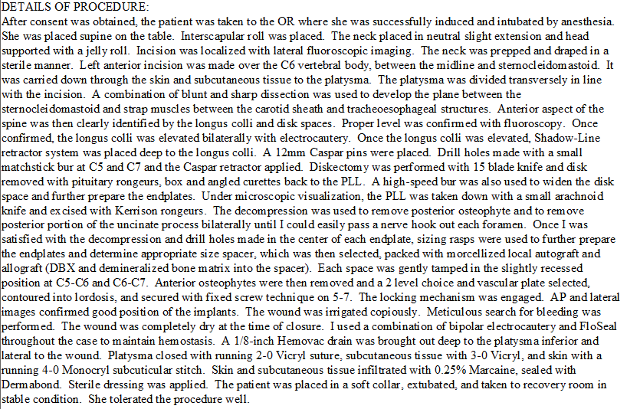
Example

Slide 35
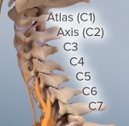
Example

Slide 36
Example

Slide 37
Example - Coding Results
22551 Arthrodesis, anterior interbody, including disc space preparation, discectomy, osteophytectomy and decompression of spinal cord and/or nerve roots; cervical below C2
22552 Arthrodesis, anterior interbody, including disc space preparation, discectomy, osteophytectomy and decompression of spinal cord and/or nerve roots; cervical below C2, each additional interspace (List separately in addition to code for separate procedure)
22845 Anterior instrumentation 2-3 vertebral segments
22853 x 2 Insertion of interbody biomechanical device with integral anterior instrumentation for device anchoring, when performed , to intervertebral disc space; in conjunction with interbody arthrodesis, each interspace
20930 Allograft for spine surgery only, morselized
20936 Autograft spine surgery local from same incision

Slide 38
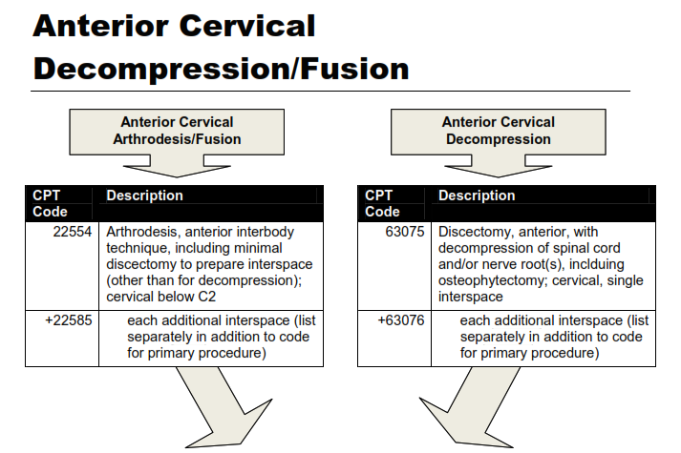
Example

Slide 39
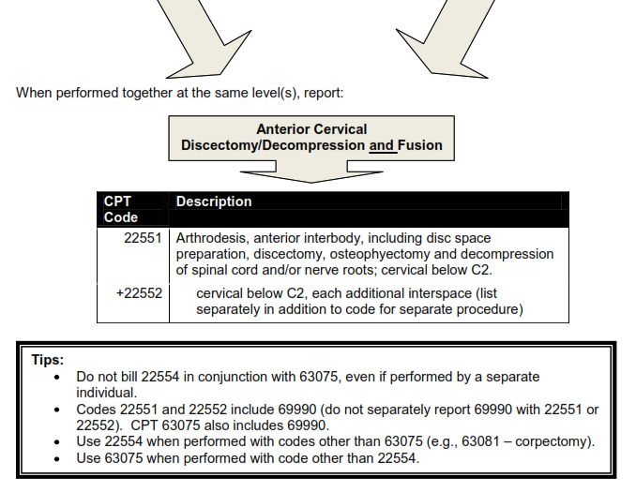
Example

Slide 40
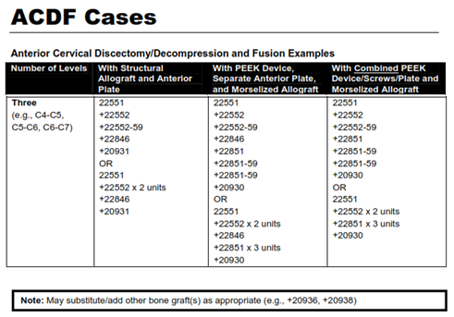
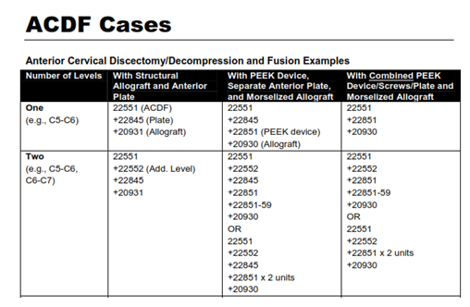
Example

Slide 41
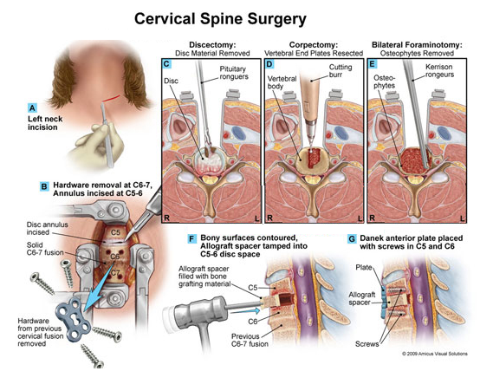
Other Example
Description: Discectomy, corpectomy, foraminotomy, graft and hardware placed.

Slide 42
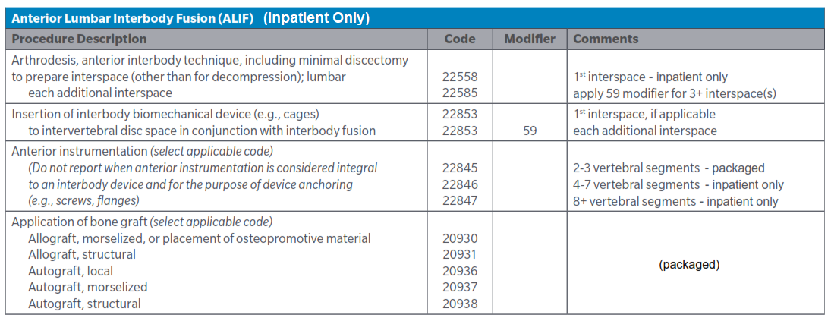
Lumbar Spinal Procedures

Slide 43
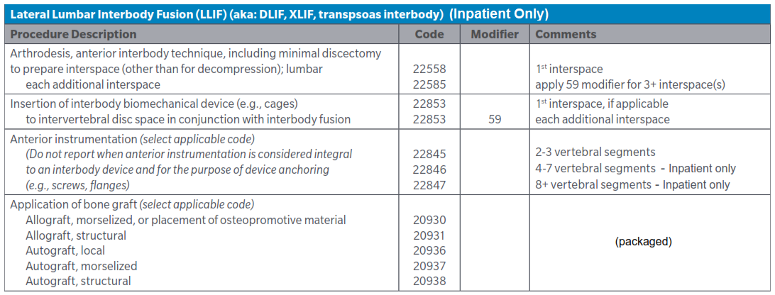
Lumbar Spinal Procedures

Slide 44
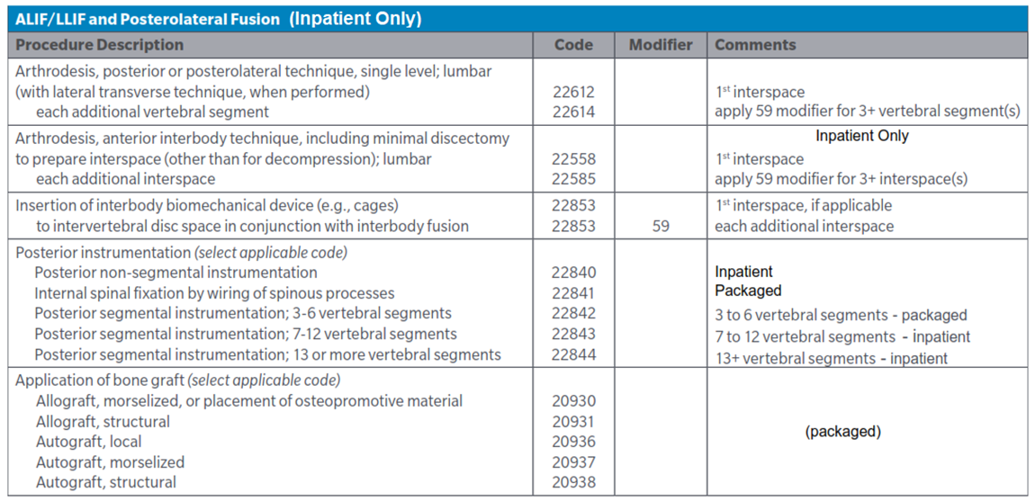
Lumbar Spinal Procedures

Slide 45
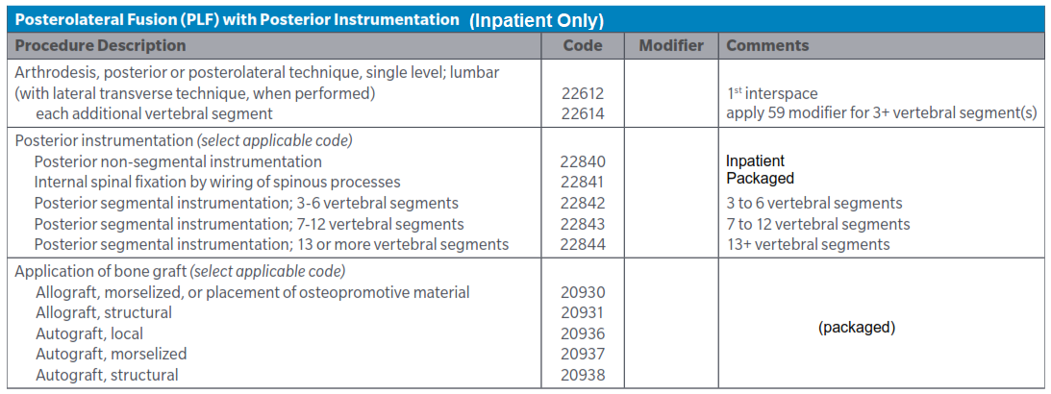
Lumbar Spinal Procedures

Slide 46
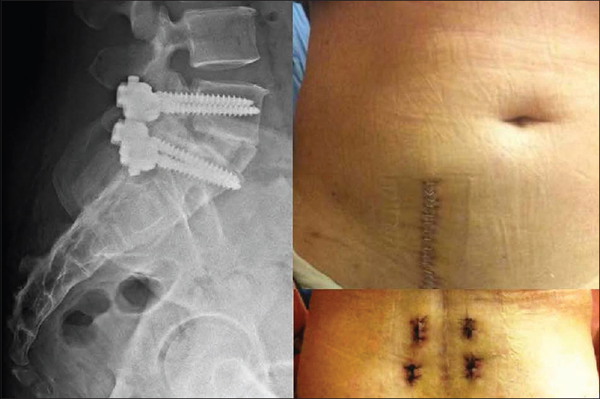
Lumbar Spinal Procedures
The left part of the figure consists of a postoperative lateral plain film of one of the patients included in this study and who had received combined anterior interbody fusion and posterior percutaneous fixation.
The right part of the figure shows the surgical wound for the anterior fusion, while the lower right part of the figure shows the small stab incisions created during the posterior fixation

Slide 47
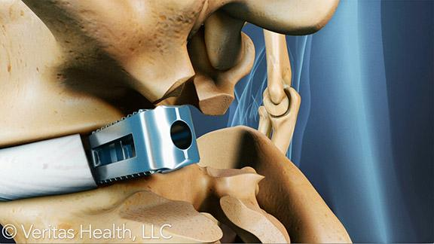
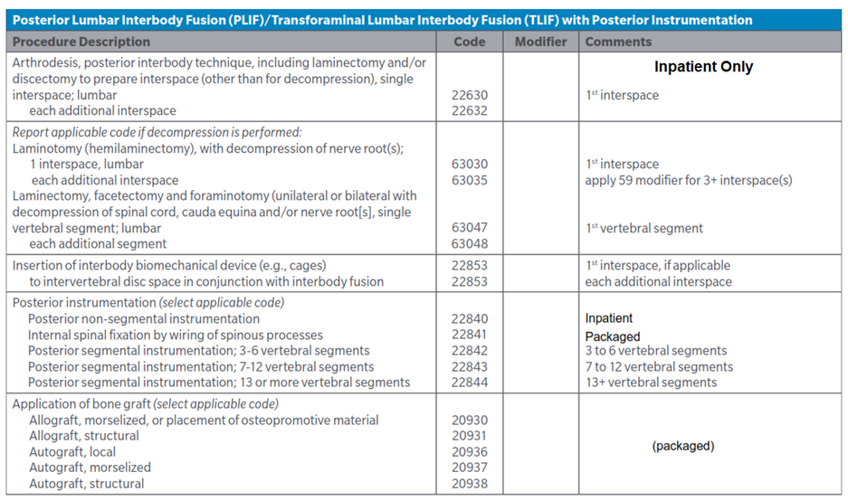
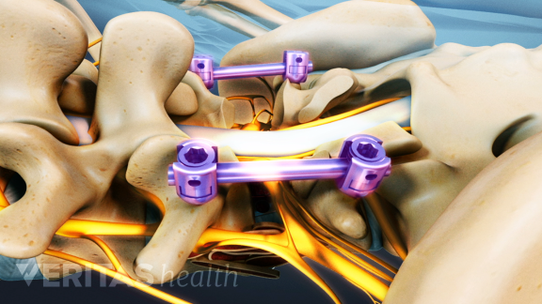
Lumbar Spinal Procedures

Slide 48
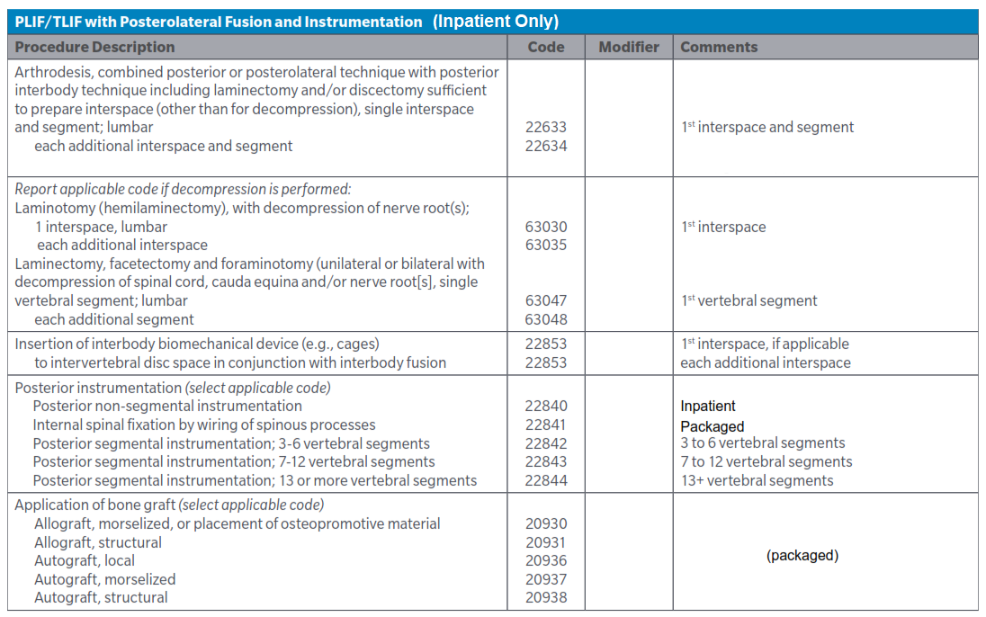
Lumbar Spinal Procedures

Slide 49
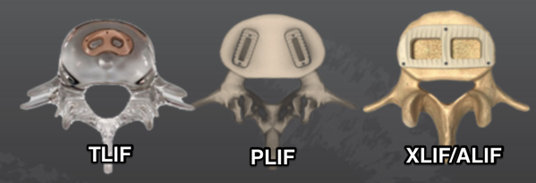
Lumbar Spinal Procedures
Physicians have preferences as to which procedure they believe is more successful (see blog URL below):
https://spinalconfusion.wordpress.com/2017/11/10/lateral-alif-is-a-true-single-position-strategy-for-lumbar-fusions/

Slide 50
Lumbar Spinal Procedures

Slide 51
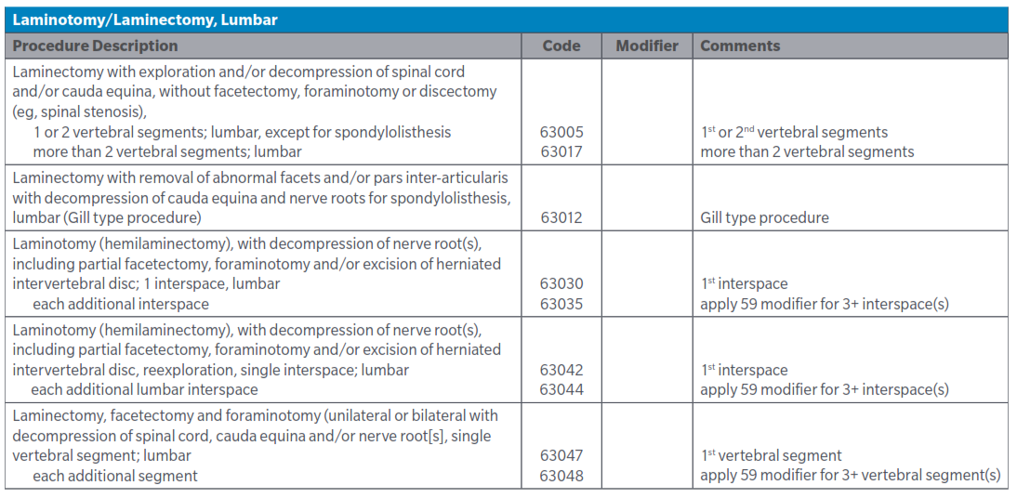
Lumbar Spinal Procedures

Slide 52
Lumbar Spinal Procedures

Slide 53
Thoracic Spinal Procedures
NOTE: There is no thoracic laminotomy or laminoplasty procedures in CPT. If your documentation details a thoracic laminotomy, an unlisted code would be used.
NOTE: Modifier -50 should not be utilized as the description states unilateral or bilateral.
NOTE: Most other thoracic spinal procedures are inpatient only.

Slide 54
Common Diagnoses & Surgery
Stenosis/Spondylosis

Slide 55
Common Diagnoses & Surgery
Stenosis/Spondylosis

Slide 56
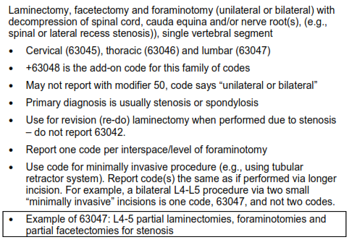
Common Diagnoses & Surgery
Stenosis/Spondylosis
NOTE: CPT Assistant, December 2012 supports the use of 63045-63048 for procedures to address stenosis and the use of 63020-63035 for procedures to treat disc disease.

Slide 57
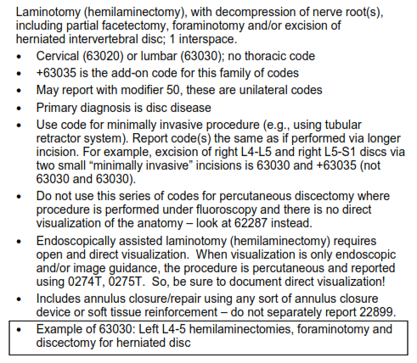
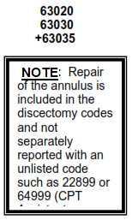
Common Diagnoses & Surgery
Disc Disease

Slide 58
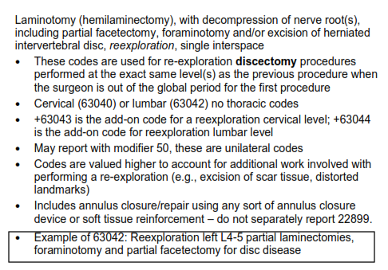
Common Diagnoses & Surgery
Disc Disease

Slide 59
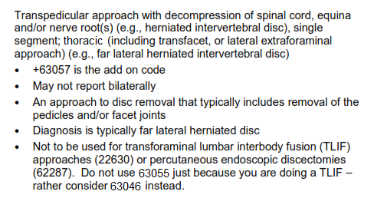
Other Laminectomy Codes
Transpedicular Approach

Slide 60
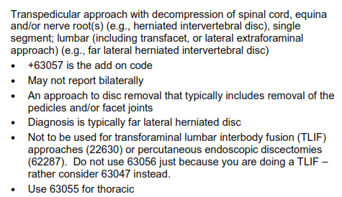
Other Laminectomy Codes
Transpedicular Approach

