Slide 1
OBGYN Outpatient Surgery Coding

Slide 2
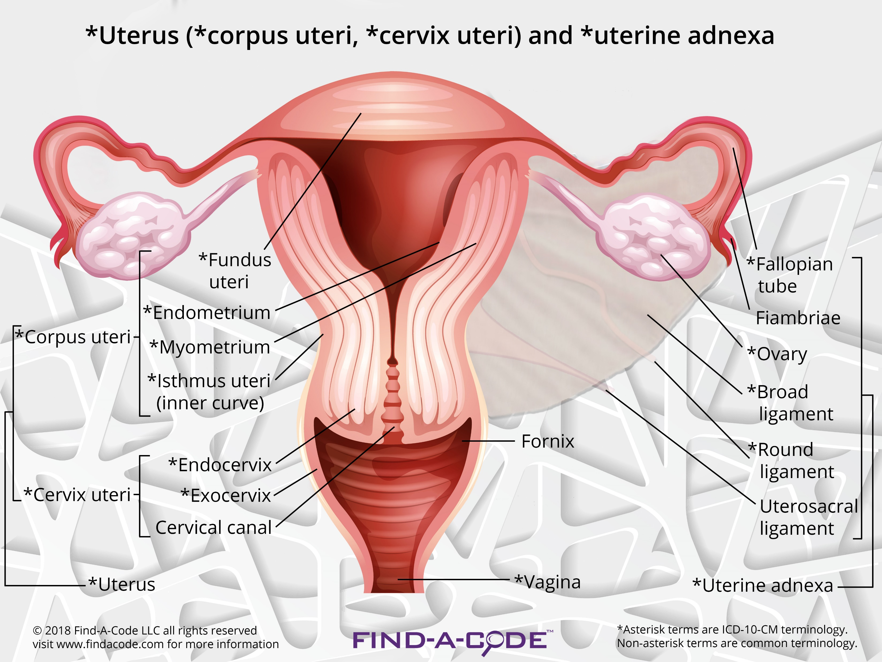
Anatomy

Slide 3
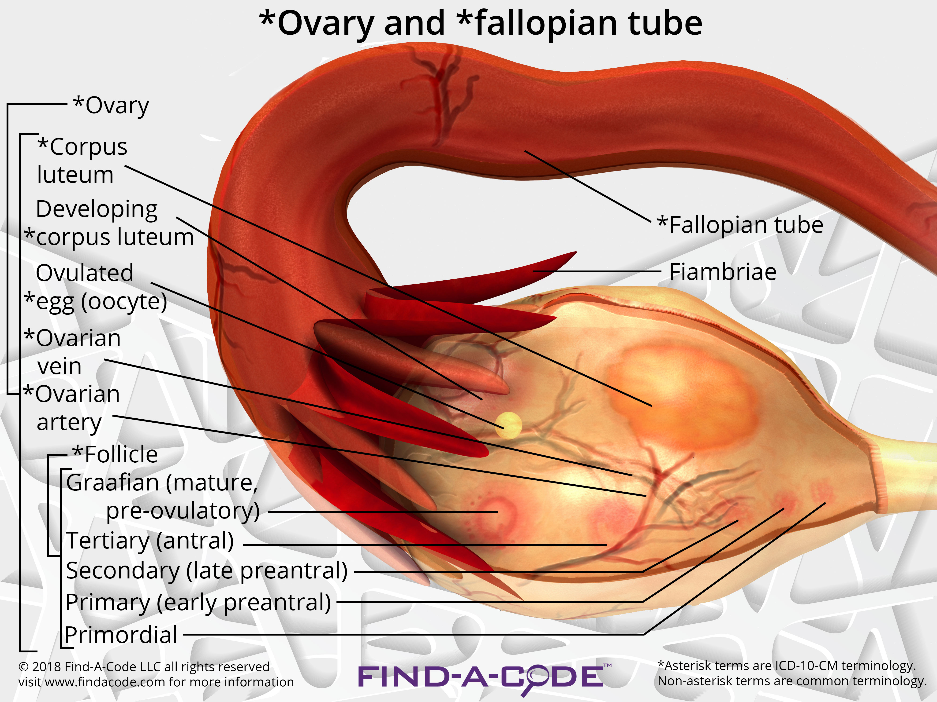
Anatomy

Slide 4
Terminology
Hyster/o – uterus, womb
Uter/o – uterus, womb
Metr/o – uterus, womb
Salping/o – tube, usually fallopian tube
Oophor/o – ovary
Ovari/o - ovary
Colpo – vagina
Cervic/o – cervix, lower part of the uterus, the “neck”
Episi/o – vulva
Vulv/o – vulva
Perine/o – the space between the anus and vulva

Slide 5
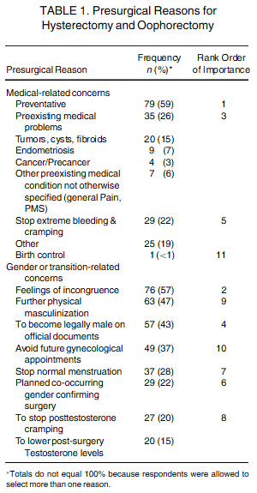
Hysterectomy
A hysterectomy is an operation to remove a woman's uterus.
A woman may have a hysterectomy for different reasons, including:
Uterine fibroids that cause pain
bleeding, or other problems.
Uterine prolapse, which is a sliding of the uterus from its normal position into the vaginal canal.

Slide 6
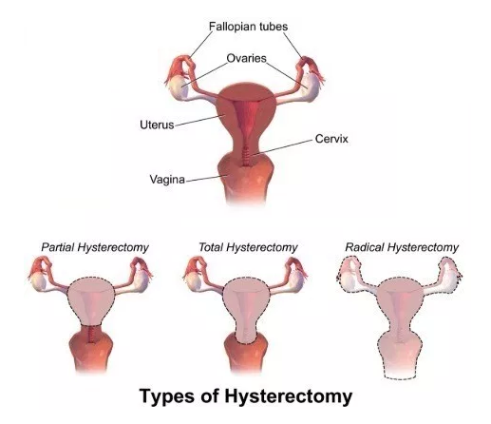
Hysterectomy
There are around 30 hysterectomy CPT codes.
To find the correct code you have to first check:
the surgical approach and
extent of the procedure.

Slide 7
Surgical Approaches
Abdominal – the uterus is removed via an incision in the lower abdomen
Vaginal – the uterus is removed via an incision in the vagina
Laparoscopic – the procedure is performed using a laparoscope , inserted via several small incisions in the body.
Their are also CPT codes for laparoscopic-assisted vaginal approach. In this procedure ,the scope is inserted via a small incisions in the vagina.

Slide 8
Extent of Procedure
Total hysterectomy: It includes laparoscopically detaching the entire uterine cervix and body from the surrounding supporting structures and suturing the vaginal cuff. It includes bivalving, coring, or morcellating the excised tissues, as required. The uterus is then removed through the vagina or abdomen.
Subtotal, partial or supracervical hysterectomy: It is the removal of the fundus or op portion of the uterus only, leaving the cervix in place.

Slide 9
Extent of Procedure
Radical hysterectomy: It includes the removal of the entire uterus and nearby tissue, the cervix and the top par to the vagina.
Laparoscopy Assisted Vaginal Hysterectomy (LAVH): It includes laparoscopically detaching the uterine body from the surrounding upper supporting structures. The vaginal portion of the procedure is then performed. The vaginal apex is entered and the cervix and uterus are detached from the remaining supporting structures. The uterus is then removed through the vagina.

Slide 10
Data to Support the Service
For coding Laparoscopic hysterectomy, the documentation should state the weight of the uterus before it is sent to pathology.
It is a procedure coded based on the size of the uterus and method used to complete the procedure.
Below are the list of CPT code used for different hysterectomy services:
Vaginal: 58260-58294
Laparoscopic-assisted, vaginal (LAVH): 58550-58554
Laparoscopic: 58541-58544, 58570-58573, 58575

Slide 11
Data to Support the Service
While coding the above CPT codes for hysterectomy, the coders should also check the other services done at the same time along with the main procedure .
For example, the total hysterectomy CPT code 58575, the procedure covers lot of other services like tumor debulking, omentectomy (removal of the omentum, part of the membrane lining the abdominal cavity), and salpingo-oophorectomy (removal of the fallopian tubes and ovaries).

Slide 12
Data to Support the Service
The additional procedures performed during the same session such as salpingo-oophorectomy, pelvic floor repairs, or mid-urethral slings, are bundled into the hysterectomy code.
Abdominal and vaginal hysterectomy (58152, 58263-58270, 58292-58294) include pelvic floor repairs to supporting structures that have prolapsed (e.g., weakened and “fallen”).

Slide 13
Hysterectomy
58150 - Total abdominal hysterectomy (corpus and cervix), with or without removal of tube(s), with or without removal of ovary(s);

Slide 14
Hysterectomy
58152 - Total abdominal hysterectomy (corpus and cervix), with or without removal of tube(s), with or without removal of ovary(s); with colpo-urethrocystopexy (e.g., Marshall-Marchetti-Krantz, Burch)

Slide 15
Hysterectomy
58180 - Supracervical abdominal hysterectomy (subtotal hysterectomy), with or without removal of tube(s), with or without removal of ovary(s)

Slide 16
Hysterectomy
58200 - Total abdominal hysterectomy, including partial vaginectomy, with para-aortic and pelvic lymph node sampling, with or without removal of tube(s), with or without removal of ovary(s)

Slide 17
Hysterectomy
58210 - Radical abdominal hysterectomy, with bilateral total pelvic lymphadenectomy and para-aortic lymph node sampling (biopsy), with or without removal of tube(s), with or without removal of ovary(s)

Slide 18
Hysterectomy
58240 - Pelvic exenteration for gynecologic malignancy, with total abdominal hysterectomy or cervicectomy, with or without removal of tube(s), with or without removal of ovary(s), with removal of bladder and ureteral transplantations, and/or abdominoperineal resection of rectum and colon and colostomy, or any combination thereof
Exenteration - is a salvage procedure performed for centrally recurrent gynecologic cancers. To a greater or lesser degree, the procedure involves en bloc resection of all pelvic structures, including the uterus, cervix, vagina, bladder, and rectum.

Slide 19
Hysterectomy
58260 - Vaginal hysterectomy, for uterus 250 g or less;
58262 - Vaginal hysterectomy, for uterus 250 g or less; with removal of tube(s), and/or ovary(s)
58263 - Vaginal hysterectomy, for uterus 250 g or less; with removal of tube(s), and/or ovary(s), with repair of enterocele
58267 - Vaginal hysterectomy, for uterus 250 g or less; with colpo-urethrocystopexy (Marshall-Marchetti-Krantz type, Pereyra type) with or without endoscopic control

Slide 20
Hysterectomy
58270 - Vaginal hysterectomy, for uterus 250 g or less; with repair of enterocele
58275 - Vaginal hysterectomy, with total or partial vaginectomy;
58280 - Vaginal hysterectomy, with total or partial vaginectomy; with repair of enterocele
58285 - Vaginal hysterectomy, radical (Schauta-type operation)
58290 - Vaginal hysterectomy, for uterus greater than 250 g;
58291 - Vaginal hysterectomy, for uterus greater than 250 g; with removal of tube(s) and/or ovary(s)

Slide 21
Hysterectomy
58292 - Vaginal hysterectomy, for uterus greater than 250 g; with removal of tube(s) and/or ovary(s), with repair of enterocele
58293 - Vaginal hysterectomy, for uterus greater than 250 g; with colpo-urethrocystopexy (Marshall-Marchetti-Krantz type, Pereyra type) with or without endoscopic control
58294 - Vaginal hysterectomy, for uterus greater than 250 g; with repair of enterocele

Slide 22
Laparoscopic Hysterectomy
58541 - Laparoscopy, surgical, supracervical hysterectomy, for uterus 250 g or less;
58542 - Laparoscopy, surgical, supracervical hysterectomy, for uterus 250 g or less; with removal of tube(s) and/or ovary(s)
58544 - Laparoscopy, surgical, supracervical hysterectomy, for uterus greater than 250 g; with removal of tube(s) and/or ovary(s)
58548 - Laparoscopy, surgical, with radical hysterectomy, with bilateral total pelvic lymphadenectomy and para-aortic lymph node sampling (biopsy), with removal of tube(s) and ovary(s), if performed

Slide 23
Laparoscopic Hysterectomy
58550 - Laparoscopy, surgical, with vaginal hysterectomy, for uterus 250 g or less;
58552 - Laparoscopy, surgical, with vaginal hysterectomy, for uterus 250 g or less; with removal of tube(s) and/or ovary(s)
58553 - Laparoscopy, surgical, with vaginal hysterectomy, for uterus greater than 250 g
58554 - Laparoscopy, surgical, with vaginal hysterectomy, for uterus greater than 250 g; with removal of tube(s) and/or ovary(s)

Slide 24
Laparoscopic Hysterectomy
In CPT 2008, the AMA published the total laparoscopic hysterectomy (TLH) set of codes (58570-58573).
This, in addition to the laparoscopic radical hysterectomy with pelvic lymphadenectomy code (58548), is the third set of CPT codes addressing the laparoscopic approach to hysterectomy.
The other CPT code sets are:
laparoscopy with vaginal hysterectomy (LAVH) (58550-58554) and
laparoscopic supracervical hysterectomy (LSH) (58541–58544) code sets.
Each of the code sets are subdivided into uteri less than or greater than 250 grams and with or without removal of tube(s) and/or ovary(s).

Slide 25
Laparoscopic Hysterectomy
Total laparoscopic hysterectomy (TLH)
Laparoscopically detaching the entire uterine cervix and body from the surrounding supporting structures and suturing the vaginal cuff.
It includes bivalving, coring, or morcellating the excised tissues, as required.
The uterus is then removed through the vagina or abdomen.

Slide 26
Laparoscopic Hysterectomy
Laparoscopy with vaginal hysterectomy (LAVH)
Laparoscopically detaching the uterine body from the surrounding upper supporting structures.
The vaginal portion of the procedure is then performed.
The vaginal apex is entered and the cervix and uterus are detached from the remaining supporting structures.
The uterus is then removed through the vagina.

Slide 27
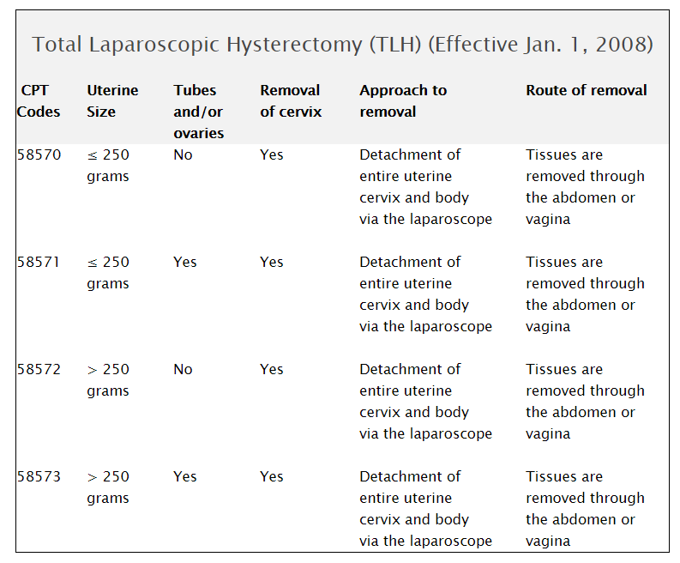
Hysterectomy

Slide 28
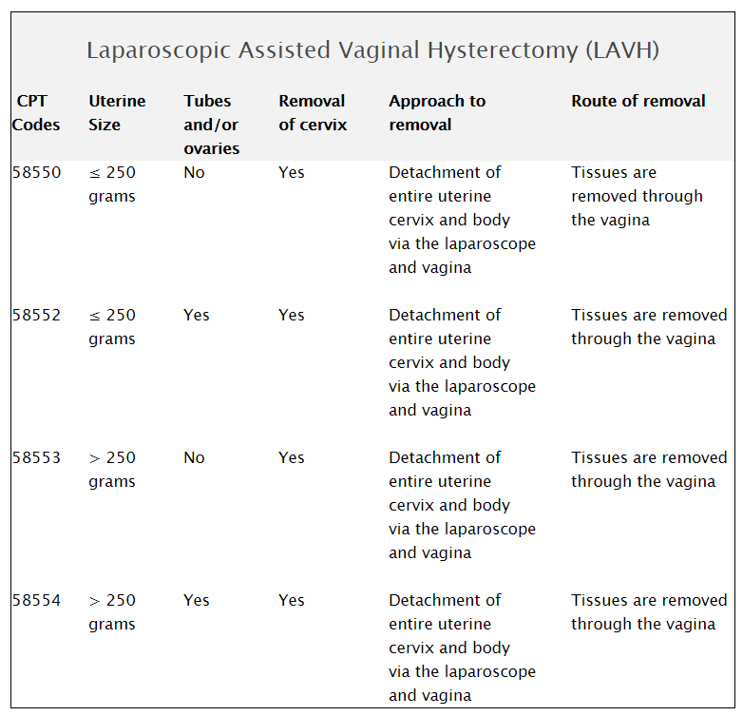
Hysterectomy

Slide 29
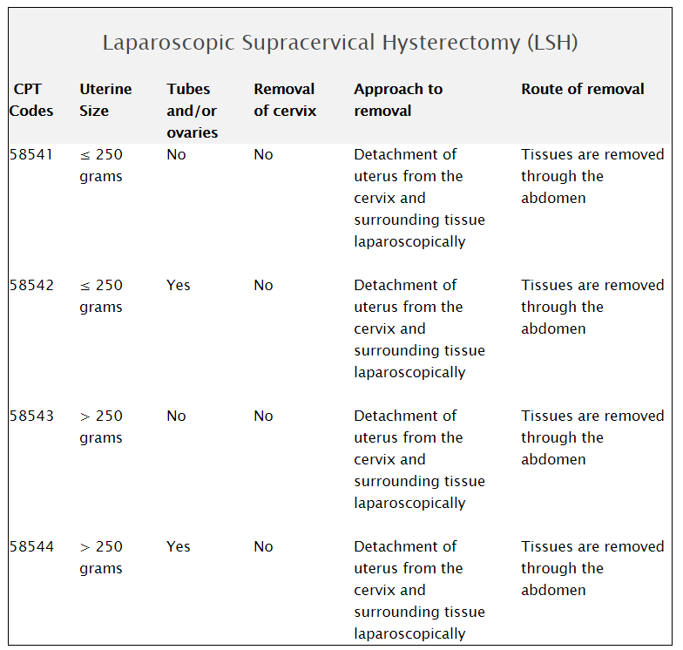
Hysterectomy

Slide 30
Hysterectomy
AMA provided a new code in 2018 for laparoscopic total hysterectomy for resection of malignancy with omentectomy as follows:
58575 Laparoscopy, surgical, with total hysterectomy for resection of malignancy (tumor debulking) with omentectomy including salpingo-oophorectomy, unilateral or bilateral, when performed

Slide 31
Hysterectomy
Code 58674 Laparoscopy, surgical, ablation of uterine fibroid(s) including intraoperative ultrasound guidance and monitoring, radiofrequency, was moved from Oviduct/Ovary to the Corpus Uteri section of CPT (ahead of code 58541) and now has a resequenced code designation (#).

Slide 32
Vaginal Repair
The code descriptions for codes 57240, 57260, and 57265 were revised in 2018 to include the words (“including cystourethroscopy, when performed”).
Parentheticals were added to each code stating that code 52000 Cystourethroscopy may not be reported with any of these codes.

Slide 33
Vaginal Repair
The repair code descriptions are as follows:
57240 Anterior colporrhaphy, repair of cystocele with or without repair of urethrocele, including cystourethroscopy, when performed
57260 Combined anteroposterior colporrhaphy, including cystourethroscopy, when performed
57265 Combined anteroposterior colporrhaphy; with enterocele repair, including cystourethroscopy, when performed

Slide 34
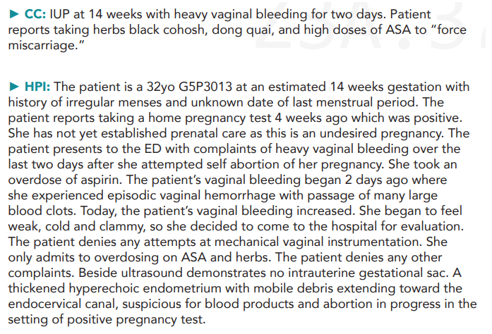
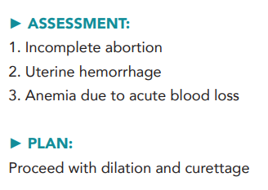
D&C Case Example

Slide 35
D&C Case Example
ICD 10 Diagnosis Coding considerations include:
O07.1 Delayed or excessive hemorrhage following failed attempted termination of pregnancy
O04.8 Vaginal Hemorrhage
O20.0 Incomplete Induced Abortion
T39.012A Poisoning from ASA
F55.1 Abuse of Herbal/Folk Remedies
D62 Acute blood loss anemia
Z31.14 14 weeks gestation of pregnancy

Slide 36
D&C Case Example
CPT-4 Code for consideration:
59812 Dilation and Curettage (Sharp or Suction) Surgical Procedure for Incomplete AB any trimester.

Slide 37
D&C
In the outpatient encounters, diagnoses may be based on patient’s primary presenting signs and symptom, such as abdominal pain, vomiting, or in this case, vaginal hemorrhage.
Most of the signs and symptom codes that are pregnancy-related are referred to as “O” codes (as in the letter “O”).
These “O” codes take precedence over any other signs/symptoms codes and should be ranked first.
Additional signs and symptoms code should be reported secondary to the primary “O” code(s).

Slide 38
D&C
In contrast, in an inpatient setting, the patient’s diagnosis codes are usually based on an established diagnosis, rather than symptomatology. So, for instance, a diagnosis of abdominal pain in an outpatient encounter, may become a diagnosis of pyelonephritis in an inpatient encounter.
Multiple OBED/triage visits may be required before a diagnosis can be established.
ICD-10cm guidelines allow us to continue to report signs and symptoms over the course of the OB outpatient/ED workup.

Slide 39
D&C
It is also important to ensure that the gestational age code, (the “Z3A” codes) is always included in your list of diagnoses.
Insurers may deny a claim based on the omission of this gestational age diagnosis. This may be ranked last.

